Slide 1

Gokaraju Rangaraju Institute of Engineering and Technology
(Autonomous)
Department of Data Science
Batch No.: DSC06
Review No.: 03
IV Year B. Tech., I Semester CSE (Data Science)
ResearchGPT: A Multi-Agent Agentic RAG Platform for Automated
Literature Review
Under the Guidance of:
Dr. S. Govinda Rao
Head of Department,
Data Science
Presented by:
1. Mr. Abrarullah Mohammed(23241A67D1)
2. Mr. G. Shashivadan Rao (23241A67F2)
3. Mr. P. Sreekaran Reddy (23241A67H7)

Slide 2
ResearchGPT: A Multi-Agent Agentic RAG Platform for Automated Literature Review

Slide 3
Abstract
  The project aims to build a multi-agent agentic RAG system that automates academic literature review using seven specialised agents — Planner, Retriever, Ranker, Extractor, Writer, Verifier and Critic — orchestrated with LangGraph. The Planner derives the search queries and coordinates the run, the Retriever pulls papers from OpenAlex, arXiv and Semantic Scholar, the Ranker keeps a one to ten ratio, and the application caches the full text of each survivor. The Verifier grounds every statement against that cache and removes what it cannot support; the Critic scores the finished review. A FastAPI backend streams live progress to a Vue 3 frontend.

Slide 4
Introduction
Writing a literature review means locating, reading and synthesising dozens of papers; the task is described in the literature as one of the most challenging in natural language processing, and no current system automates it end to end.
This project therefore automates literature review using seven specialised agents (Planner, Retriever, Ranker, Extractor, Writer, Verifier and Critic) orchestrated as a stateful LangGraph graph, in which the Ranker keeps a one to ten ratio and the application then fetches and caches the full text of each paper that survives.
A claim-verification model trained on SciFact and running locally classifies every atomic claim against the cached source text it cites, removes the unsupported ones and attaches a citation to each claim that survives, while a human reviewer confirms or overrides what was dropped and the Critic scores the finished review.
The result is delivered as a full-stack application, a FastAPI backend streaming Events to a Vue 3 frontend with clickable and downloadable artefacts.

Slide 5
Existing Approaches (Literature Survey)
Ref. No. & Year | Problem | Dataset | Algorithm | Evaluation metrics | Advantages | Limitations
[1] 2025 | No standardised dataset existed to judge LLM-generated scientific surveys against human-written ones. | SurveyGen (own): 4,200+ human-written surveys with section-level structure; 242,143 cited references. | QUAL-SG: quality-aware extension of RAG that reranks retrieved literature using citation count, author influence and venue reputation; three task settings by degree of human involvement. | Semantic similarity to human surveys; ROUGE-L; citation precision / recall / F1; structural consistency. | Exact task match; quality-aware reranking lifts citation F1 to 16.73%, beating UPR (10.45) and RankGPT (14.81); human-involvement gradient isolates where automation fails. | Restricted to abstracts and metadata for copyright reasons; best citation accuracy only 35.84%; no post-generation refinement; only 120 short surveys evaluated.
[2] 2023 | No large-scale dataset existed for automatic literature review generation, blocking progress on the task. | SciReviewGen (own): 10,000+ computer-science literature reviews and 690,000 cited papers, built from S2ORC. | QFiD (Query-weighted Fusion-in-Decoder) weighting each cited paper by relevance; baselines LEAD, LexRank, extractive oracle, BigBird, FiD; SciBERT quality classifier. | ROUGE-1 / 2 / L; three-way human evaluation of chapter quality; Cohen’s kappa. | The field’s reference dataset, in computer science; two-stage quality control (kappa 0.66; SciBERT F1 92%); QFiD best at ROUGE-1 34.00; honest negative human results. | Abstracts only as input; chapters generated independently; inter-paper relations ignored; output "contains incorrect information"; annotator agreement only kappa 0.212.

Slide 6
Existing Approaches (Literature Survey)
Ref. No. & Year | Problem | Dataset | Algorithm | Evaluation metrics | Advantages | Limitations
[3] 2023 | Citation text generation studies use widely diverging task definitions, so results cannot be compared or accumulated. | CiteBench, unifying ABURAED, XING, CHEN Delve and Multi-XScience; references S2ORC and arXiv. | Unified benchmark and task format; LED baselines (led-base, led-large-arxiv) with cross-dataset transfer experiments; citation-intent discourse analysis. | ROUGE-L and BERTScore; KL divergence over citation-intent distributions; human ratings of readability and consistency; Cohen’s kappa. | Solves a real fragmentation problem; rare cross-dataset transfer study; discourse analysis goes beyond n-gram overlap; finds ROUGE configuration alone shifts scores ~3 points. | English only; automatically inferred labels; data shipped as fetch scripts; citation text is far smaller than a review chapter; pre-dates current LLMs.
[4] 2024 | AI-assisted systematic-review tooling has proliferated with no systematic map of what exists or how tools compare. | None. Reviews 21 leading SLR tools plus 11 recent LLM-based tools; sources include Scopus, Semantic Scholar, PubMed and CORE. | Systematic review protocol; assessment framework of 23 traditional features and 11 AI features across technical, usability and economic categories. | Feature coverage per tool; recommends the F2 score in place of F1 for the screening stage. | Maps the real competitive landscape rather than only papers; ready-made comparison instrument; concrete transparency and metric guidance; 167 references. | No system, benchmarking or head-to-head performance data; tool landscapes date quickly; focused on screening and extraction, light on synthesis and writing.

Slide 7
Existing Approaches (Literature Survey)
Ref. No. & Year | Problem | Dataset | Algorithm | Evaluation metrics | Advantages | Limitations
[5] 2025 | LLM literature tools hallucinate citations, and existing frameworks either lack end-to-end pipelines or cannot handle large claim batches. | SciFact for evaluation; Semantic Scholar as the live retrieval corpus; references MultiVerS and S2ORC. | RAG combined with structured bibliometric scoring and chain-of-thought guided prompt-flow; asynchronous parallelisation; works with any OpenAI-compatible model. | Precision, recall, F1 and an uncertainty (abstention) rate; ablations on retrieval depth and bibliometric scoring. | Valsci with GPT-4o-mini (F1 0.720) beats bare GPT-4o (0.706); eliminates citation hallucination by construction; self-hostable on an 8 GiB virtual machine. | Evaluation described as preliminary; verifies claims but does not synthesise a review; biomedical framing; prompted LLM rather than a trained verifier; abstains on about a third of claims.
[6] 2024 | Evaluating RAG pipelines needs costly human reference annotation across both retrieval and generation dimensions. | WikiEval (own), a small paired high/low-quality set built for validating the three metrics. | Reference-free LLM-judged metric suite: faithfulness computed as F = |V| / |S| over decomposed statements, answer relevance and context relevance; LlamaIndex and LangChain integrations. | Faithfulness, answer relevance, context relevance; agreement with two human annotators. | No ground truth required; the faithfulness formula is simple and directly implementable; ~95% annotator agreement on WikiEval; de-facto standard with 330+ citations. | Demonstration track; metrics are LLM-judged and inherit judge bias; reference-free scores measure internal consistency, not truth; WikiEval is small and general-domain.

Slide 8
Existing Approaches (Literature Survey)
Ref. No. & Year | Problem | Dataset | Algorithm | Evaluation metrics | Advantages | Limitations
[7] 2023 | Binary factuality judgements are inadequate for long-form text that mixes supported and unsupported information, and human evaluation is costly. | People biographies with Wikipedia as knowledge source; 6,500 generations from 13 language models. | Decompose a generation into atomic facts and compute the percentage supported by a named knowledge source; automated estimator combining retrieval with a strong LM. | FActScore (percentage of supported atomic facts); estimator error rate against human labels. | Estimator within 2% of human judgement; replaced $26,000 of manual annotation; gives a principled definition of precision relative to a named corpus. | Biographies and Wikipedia only; measures precision without recall; explicitly "not applicable when the facts are more nuanced, open-ended, and debatable".
[8] 2023 | No reproducible benchmark existed for judging whether LLM-generated text is actually supported by the sources it cites. | ALCE, comprising ASQA, QAMPARI and ELI5 over a 21-million-passage Wikipedia corpus; DPR, GTR and BM25 retrievers. | Benchmark with NLI-computed citation recall and precision; strategies compared include vanilla, post-hoc citation attachment, reranking by citation recall, snippets and interactive inspection. | Fluency via MAUVE; correctness via exact match or claim recall; citation recall and citation precision, both validated against human annotation. | First reproducible end-to-end citation benchmark; metrics validated against humans (kappa 0.698 recall, 0.525 precision); three-dimensional design resists shortcut gaming. | Best models lack complete citation support 50% of the time; MAUVE unstable with output length; the NLI model cannot detect partial support; no multi-hop or reasoning coverage.

Slide 9
Existing Approaches (Literature Survey)
Ref. No. & Year | Problem | Dataset | Algorithm | Evaluation metrics | Advantages | Limitations
[9] 2024 | Hallucination research lacked a unified taxonomy, and the limits of retrieval augmentation as a remedy were undocumented. | None. Survey drawing on 214 references. | Taxonomy of hallucination in the LLM era; systematic review of contributing factors, detection methods, benchmarks and mitigation methodologies. | Reviews existing detection benchmarks and mitigation evaluations; proposes no new metric. | 1,757 citations; explicitly analyses where retrieval-augmented LLMs fail to prevent hallucination; introduces the knowledge-boundary concept. | Survey with no method or experiments; scientific-domain hallucination treated shallowly; 2024 cut-off already misses recent mitigation work.
[10] 2024 | Verifying scientific claims against the clinical trial literature is manual and does not scale to publication volume. | CoVERt (own): 15 PICO-encoded claims, 96 labelled abstracts, Fleiss kappa 0.684; SciFact; 189,648 PubMed abstracts. | CliVER: retrieve abstracts, extract pertinent sentences, apply PICO framing, then a majority-vote ensemble of RoBERTa, PubMedBERT and T5 predicting Support / Refute / Neutral. | Macro-F1; Precision@K, MRR@K and NDCG@K for ranking; label agreement against four medical clinicians. | Three-way label space; the Oracle versus Open evaluation split isolates retrieval error from verification error; ensemble reaches macro-F1 0.93 on SciFact; benchmarked against clinicians. | 0.93 Oracle falls to 0.85 Open, 0.797 against clinicians and 0.44 in the worst domain; 21% false-Support rate; recall not measured; three-transformer ensemble is expensive.

Slide 10
Existing Approaches (Literature Survey)
Ref. No. & Year | Problem | Dataset | Algorithm | Evaluation metrics | Advantages | Limitations
[11] 2024 | Extracting structured knowledge from scientific prose remains a hard task for machine learning models. | Three materials-chemistry tasks (host–dopant, metal-organic frameworks, general composition/phase/morphology); 77-sentence hold-out; five-fold cross-validation. | LLM-NERRE: fine-tuned GPT-3 and 8-bit quantised Llama-2-70B for joint named-entity and relation extraction; JSON versus English-sentence output schemas compared. | Exact word-match relation F1 plus a holistic manual F1 assigned by a domain expert. | Nature-family precedent for structured JSON extraction from papers; beats seq2rel (F1 0.496) and MatBERT (0.390); the dual scoring regime is itself a reusable contribution. | Output schema validity is not enforced; models invent information absent from the input; pairwise relations cannot capture all scientific content; no evidence-span or provenance mechanism.
[12] 2024 | Citations frequently misrepresent what the cited paper said, and citation integrity had not been studied from an NLP perspective. | Own annotated corpus: 100 highly-cited biomedical publications, 3,063 citation instances, 39.18% containing accuracy errors. | Citation context identification, then BM25 + MonoT5 top-20 evidence retrieval, then fine-tuned MultiVerS three-way accuracy classification; GPT-3.5 and GPT-4 in-context baselines. | Precision, recall, micro- and macro-F1; recall@k and MRR for evidence retrieval; inter-annotator kappa. | The closest published analogue to claim-level citation verification; exceptionally honest per-stage reporting; public corpus and models. | Best model only 0.59 micro-F1; evidence retrieval recall 0.53; annotator agreement 0.18–0.31; biomedical domain; requires fine-tuning and a MonoT5 reranker.

Slide 11
Existing Approaches (Literature Survey)
Ref. No. & Year | Problem | Dataset | Algorithm | Evaluation metrics | Advantages | Limitations
[13] 2024 | A single retrieval strategy either wastes computation on simple queries or fails on complex multi-step ones. | SQuAD, Natural Questions and TriviaQA (single-hop); MuSiQue, HotpotQA and 2WikiMultiHopQA (multi-hop). | A smaller-LM complexity classifier routes each query to no retrieval, single-step retrieval or iterative retrieval; training labels built automatically from model outcomes and dataset bias. | F1, exact match and accuracy; time per query and number of retrieval steps. | Improves efficiency and accuracy together rather than trading them; labels need no human annotation; small classifiers match large ones, so routing is cheap. | Automatic labelling may mislabel complexity; a measurable gap remains to an oracle classifier; routing is decided once before retrieval and never revised.

Slide 12
Existing Approaches (Literature Survey)
Ref. No. & Year | Problem | Dataset | Algorithm | Evaluation metrics | Advantages | Limitations
[14] 2024 | Irrelevant retrieved documents mislead generation, and retrieved content suppresses the model’s own reliable intrinsic knowledge. | TriviaQA and RealTimeQA named; three open-domain QA sets for main results; 10K GPT-4-generated note set; LLaMa-2 7B. | CHAIN-OF-NOTE generates a sequential reading note assessing each retrieved document before answering; deployed by prompting GPT-4 and by distillation into LLaMa-2 7B. | Exact match and F1 for open-domain QA; rejection rate for unanswerable and real-time questions; accuracy for GPT-4. | Explicit and measurable refusal capability; +7.9 EM under fully noisy documents; per-document notes are inherently interpretable; distillation into a 7B model works. | One extra generation pass per retrieved document raises cost and latency; note quality fluctuates with document complexity; distillation requires frontier-model access.
[15] 2024 | Generic retrieval-augmented models generalise poorly to specialist domains, fetching incorrect documents and making inaccurate judgements. | 84k filtered biomedical instruction sets; three medical QA benchmarks and two long-form QA benchmarks. | Self-BioRAG: domain-specific retriever plus a model trained to emit customised reflective tokens that assess its own generated explanations; 7B and 13B weights released. | Accuracy on medical QA benchmarks; ROUGE-1 on long-form QA. | +7.2% absolute over comparable models at 7B or below; +8% ROUGE-1 over RAG on long-form output; full release of weights, data and code. | Requires 84k curated domain instructions; biomedical only; reflection is internal to the model so it cannot be audited or ablated; 7B inference impractical on CPU.

Slide 13
Existing Approaches (Literature Survey)
Ref. No. & Year | Problem | Dataset | Algorithm | Evaluation metrics | Advantages | Limitations
[16] 2025 | Standard RAG struggles to retrieve precisely relevant context from dense, fast-moving academic literature. | Custom data-science query set (unreleased); textbook corpus used for embedding fine-tuning. No public benchmark. | Four coordinated stages: GROBID structured parsing, textbook-derived domain embedding fine-tuning, semantic chunking, and an "Abstract First" retrieval strategy. | RAGAS Context Relevance, with ablations against configurations using only subsets of the four enhancements. | Ablation-driven design; reports a more than fifteen-fold Context Relevance gain over baseline RAG; Scopus-indexed Elsevier venue. | A single metric only; bespoke unreleased query set so the gain is not independently comparable; domain-locked by textbook fine-tuning; heavy GROBID infrastructure.
[17] 2025 | Multi-hop questions defeat standard RAG because the required facts are distributed across several documents rather than co-occurring in one. | MultiHop-RAG and HotpotQA; generation with Qwen2.5-32B-Instruct. | An LLM decomposes the query into sub-questions, passages are retrieved per sub-question, and the merged candidate pool is reranked by an off-the-shelf cross-encoder; no extra training. | Hits@4, Hits@10, MAP@10 and MRR@10 for retrieval; F1, exact match, precision, recall plus supporting-fact and joint metrics for answers. | +16.5% Hits@10 and +8.4% MRR@10 over the published baseline despite a smaller embedding model; careful per-component attribution; drop-in with no training. | Sub-queries are generated once and never updated from retrieved evidence; gains depend on a strong domain-aligned reranker; decomposition can hurt already-specific queries.

Slide 14
Existing Approaches (Literature Survey)
Ref. No. & Year | Problem | Dataset | Algorithm | Evaluation metrics | Advantages | Limitations
[18] 2024 | Phase-specific models fragment multi-stage workflows, causing technical inconsistency across phases of a development process. | None. Evaluated on software-development tasks rather than a public benchmark; ChatGPT and GPT-4 as backbones. | Role-specialised LLM agents across design, coding and testing, coordinated by a "chat chain" controlling what is communicated and "communicative dehallucination" controlling how. | Completeness, executability, consistency and overall quality of the produced software. | Canonical peer-reviewed evidence that role decomposition beats monolithic prompting; explicitly recognises hallucination at agent interfaces; over 1,000 citations. | Agent capability is overestimated and suited to prototypes only; no retrieval or evidence grounding; multiple agents cost more tokens and time; no quantitative benchmark.
[19] 2024 | LLM-based multi-agent systems proliferated without a unifying account, making architectures difficult to compare. | None. Survey drawing on 254 references across 43 pages. | Five-component framework — profile, perception, self-action including memory, mutual interaction and evolution; applications split into problem-solving and world simulation. | None; descriptive classification rather than empirical measurement. | Comprehensive vocabulary for describing agent architectures; catalogues hallucination-mitigation families including verification chains, multi-agent debate and plan revision on failure. | No evaluation or empirical comparison; components are descriptive not prescriptive; no document- or retrieval-specific content; young venue whose indexing must be confirmed.

Slide 15
Existing Approaches (Literature Survey)
Ref. No. & Year | Problem | Dataset | Algorithm | Evaluation metrics | Advantages | Limitations
[20] 2025 | Coordinating heterogeneous agents in complex, dynamic environments is costly and unstable, with coordination overhead dominating. | Logistics, inspection and search-and-rescue scenarios; no public dataset. | Multi-tier hybrid architecture: a cloud-based LLM central planner plus device-specific LLMs and generative agents, combined with classical control algorithms and real-time feedback. | Task completion accuracy; number of communication steps; token usage and API call counts. | +5.7% task accuracy with −46% communication steps and −31% token usage; publishes the efficiency numbers most multi-agent papers omit; IEEE Q1 venue. | Robotics and IoT domain so transfer is architectural only; requires a cloud LLM planner; scenario-based evaluation with no public benchmark for replication.

Slide 16
Existing Approaches (Literature Survey)
Ref. No. & Year | Problem | Dataset | Algorithm | Evaluation metrics | Advantages | Limitations
[21] 2025 | Flat vector retrieval discards relational structure between entities, limiting reasoning over connected knowledge. | None. Survey with a maintained live repository of GraphRAG work. | Formalises GraphRAG as graph-based indexing, graph-guided retrieval and graph-enhanced generation; covers core technologies, training methods and industrial use cases. | Reviews downstream task evaluation practice; contributes no new metric. | First systematic treatment of GraphRAG; clean three-stage formalisation; documents real industrial deployments. | Young area whose novelty the authors acknowledge; graph construction cost understated by survey framing; no comparative benchmarking against flat RAG, so the benefit is unquantified.
[22] 2024 | RAG benchmarks focus on question answering and assess only the LLM or the retriever, overlooking knowledge-base construction. | CRUD-RAG (own, Chinese) with four sub-datasets covering Create, Read, Update and Delete scenarios; code publicly released. | CRUD taxonomy of RAG applications with a separate dataset per category; component-wise analysis of retriever, context length, knowledge-base construction and LLM. | Task-appropriate generation metrics per CRUD category, reported per component rather than end-to-end only. | Evaluates the whole pipeline rather than the generator alone; covers summarisation and content creation, not just QA; uniquely evaluates knowledge-base construction; public code. | Chinese-language data only so it is not directly reusable; the CRUD framing fits generation loosely; no agentic or multi-step scenarios.

Slide 17
Existing Approaches (Literature Survey)
Ref. No. & Year | Problem | Dataset | Algorithm | Evaluation metrics | Advantages | Limitations
[23] 2023 | RAG was trained and explored only on Wikipedia and degrades badly on specialised domains such as healthcare and news. | COVID-19 (CORD-19), News and Conversations domains; SQuAD open-domain; DPR, BART, BERT and BM25 models. | RAG-end2end: joint end-to-end training of retriever and generator with periodic knowledge-base re-encoding, plus an auxiliary sentence-reconstruction training signal. | Exact match, F1, and Top-5 / Top-20 retrieval accuracy. | Consistent large gains across three domains (EM +1.13 to +12.16) and +11.9 EM on SQuAD; open-sourced into HuggingFace Transformers; identifies the retriever as the key driver. | Requires full end-to-end training with periodic re-indexing, which fails if the knowledge base is not entirely updated; restricted to open-domain QA; pre-dates instruction-tuned LLMs.

Slide 18
Existing Approaches (Literature Survey)
[1] T. Bao, M. T. Nayeem, D. Rafiei and C. Zhang, "SurveyGen: Quality-Aware Scientific Survey Generation with Large Language Models," EMNLP 2025.
Given a query, automatic survey generation requires a large language model to generate the literature survey for the query in the form of the papers retrieved. Progress in the field had been hindered by the lack of a common dataset by which the output of machine output could be compared with human-written surveys.
The goal is to release the large structured evaluation set so that we can rigorously evaluate generated surveys. It also intends to show that choosing higher-quality source papers at retrieval results to better citations from a generated survey.
The authors publish SurveyGen, a collection of 4,236 human-authored surveys with section-level organization and 242,143 references annotated with citation metrics (citation counts, author influence, venue reputation). They introduce QUAL-SG, a quality-aware variation of naive RAG that takes such quality indicators into account to rerank literature prior to generation. This is tested under three human-guided recovery levels freely-generated, spill-over to fully-automatic RAG, and human-directed generation with perfect references and outline queries.
LLaMA-3.1-70B achieved the best similarity to human generated surveys at 82.43% with a ROUGE-L of 15.36%, whereas the qualifiers QUAL-SG obtained the best citation quality with an F1 of 16.73% outpacing Naive-RAG and Fully-LLMGen by 10.80 and 8.97 points, respectively. However, the citation accuracy only reached 35.84% at most, and thus led the authors to infer that using only LLMs is inadequate in generating trustworthy references.
The pipeline only incorporates abstracts and bibliographic metadata, which the authors argue may result in generated surveys being shallow and incomplete, and the lack of a post-generation refinement and verification stage. The obvious future is to incorporate full text generation and an explicit claim-verification stage that eludes unsupported claims before writing.

Slide 19
Existing Approaches (Literature Survey)
[2] T. Kasanishi, M. Isonuma, J. Mori and I. Sakata, "SciReviewGen: A Large-Scale Dataset for Automatic Literature Review Generation," Findings of ACL 2023.
Introduction: Literature review generation is described by its authors as one of the most challenging tasks in natural language processing, because it requires synthesising many papers into coherent prose. Progress had been blocked by data, since no large-scale corpus pairing reviews with their cited papers existed.
Objective: The work aims to release a dataset large enough to train and benchmark review generation models. It also aims to establish baseline performance and measure how close automatic output comes to human-written reviews.
Methodology: The authors build SciReviewGen from S2ORC, comprising over 10,000 computer-science literature reviews and 690,000 cited papers. Quality control was two-stage: human annotators screened candidate reviews, accepting 583 of 889 at Cohen’s kappa 0.66, and those labels trained a SciBERT classifier reaching 92% F1 that filtered the remainder automatically. They then propose QFiD, a query-weighted Fusion-in-Decoder that weights each input document by relevance to the chapter query, evaluated against LEAD, LexRank, an extractive oracle, BigBird and vanilla FiD.
Results: QFiD achieved the best scores with ROUGE-1 34.00, ROUGE-2 7.75 and ROUGE-L 16.52, and the FiD-based models outperformed the extractive oracle, showing that simply copying sentences from cited papers does not work and the task is genuinely abstractive. Human evaluation found only about 30% of generated chapters competitive with or superior to human-written text, at an inter-annotator agreement of kappa 0.212.
Limitations and future scope: The authors list five limitations: only abstract text is used as input, only 70% of cited papers have accessible body text, chapters are generated independently so cross-chapter coherence is impossible, relations between cited papers are ignored, and the generated text "contains incorrect information" so it cannot be published without human revision. Supplying full text, modelling inter-paper relations and verifying generated statements are therefore the stated future directions.

Slide 20
Existing Approaches (Literature Survey)
[2] T. Kasanishi, M. Isonuma, J. Mori and I. Sakata, "SciReviewGen: A Large-Scale Dataset for Automatic Literature Review Generation," Findings of ACL 2023.
Generation of a literature review is identified by the authors as one of the most difficult elements of NPL because it involves integration of a large number of papers into a single piece of text. Efforts had been stranded by the unavailability of data; no large scale corpus
The work is intended to release a sufficiently large dataset for training and benchmarking systems to produce review generation. It also intended to set baselines and impact measures of the distance an automatic system is from a human produced review.
The authors construct SciReviewGen from S2ORC, a dataset of >10k computer-science paper reviews, and 690k cited papers. Quality control was two-stage: human assessors selected 583 of 889 candidate reviews (Cohen’s κ=0.66) for labeling, training a SciBERT classifier which achieved 92% F1 for filtering out the rest. They then develop QFiD, a query-weighted Fusion-in-Decoder that assigns weight to each input document by its relevance to the chapter query, testing against LEAD, LexRank, an extractive oracle, BigBird and vanilla FiD.
QFiD has the best scores (ROUGE-1 34.00, ROUGE-2 7.75 and ROUGE-L 16.52), and the FiD-based models outperforming the extractive oracle demonstrated the task to be truly abstractive and that naively copying sentences from cited papers doesn‘t work. Human evaluation found only ~30% of generated chapters to be competitive with/ better than human written at inter-annotator agreement of kappa 0.212
Authors note 5 limitations: input is the abstract only, 70% of cited papers have body available, each chapter is produced discretely so cross chapter consistency cannot be guaranteed, no relations between cited papers models and the generated text “contains false information” that cannot be published without human editing. Will produce the full text, model relations between papers and implement fact checking of the generated statements.

Slide 21
Existing Approaches (Literature Survey)
[3] M. Funkquist, I. Kuznetsov, Y. Hou and I. Gurevych, "CiteBench: A Benchmark for Scientific Citation Text Generation," EMNLP 2023.
Generation of the citation text produces the sentences that cite the paper in a related work section. Studies have shown that it can not collect, because it is impossible, as the authors point out, “it is based on widely diverging task definitions”.
The hope is to unify various task definitions into a single benchmark with standardised evaluation. The primary goal is to test whether other citation-generation models transfer.
CiteBench combines four existing citation generation datasets (ABURAED, XING, CHEN Delve and Multi-XScience). All are integrated into a single task format, with a single evaluation protocol. Longformer Encoder-Decoder models are finetuned on each dataset and (zero-shot) evaluated across all others to quantify transfer. In addition to ROUGE-L and BERTScore, the authors report discourse analysis comparing the KL divergence of citation-intent distributions of generated/gold text, and a human qualitative assessment of a 50-instance subsample..
Results: Models exhibited non-trivial transfer across datasets, but no system received more than a 3 on the consistency dimension, with raters commenting the generated text failed to include significant content verifable facts about the referenced papers yet was related to the same topic. Inter-annotator agreement was around 0.50 for readability, between 0.18 and 0.42 for consistency, and various robert pack combinations varied scores by around three.
Limitations and future scope: The baseline is only English, uses automatically inferred labels, and can only ship fetch-and-transform scripts (instead of the data itself) due to reuse restrictions. They determine that existing task definitions “grossly oversimplify the inherently complex chore of composing a related work section”, leading to the conclusion that full-section factually grounded generation is the needed subsequent goal.

Slide 22
Existing Approaches (Literature Survey)
[4] F. J. Bolaños, A. A. Salatino, F. Osborne and E. Motta, "Artificial Intelligence for Literature Reviews: Opportunities and Challenges," Artificial Intelligence Review, vol. 57, 2024.
Introduction: There are dozens of tools that may seem to automate some stage of a systematic literature review, but no two tools were ever directly compared under a common framework. Bolaños et al., take stock of the tools in the field, to understand what they can do and where AI actually assists.
Objective: The review aims to map the capabilities of existing systematic-review tools against a consistent feature framework. It also aims to give developers concrete guidance on evaluation metrics, usability and transparency.
Methodology: The authors systematically review 21 leading SLR tools against 23 traditional features and 11 AI features, concentrating on the screening and extraction phases. A further 11 recent LLM-based tools for literature search and academic writing are assessed separately. Tools are scored across technical, usability and economic categories, and the search string is reported in full so the review can be reproduced.
Results: Three primary research challenges emerge: integrating advanced AI such as large language models and knowledge graphs, improving usability, and developing a standardised evaluation framework. The authors recommend the F2 score rather than F1 for screening, because missing a relevant paper is far costlier than reviewing an irrelevant one, and they call for traceability, explainability and explicit disclosure of each tool’s limitations.
Limitations and future scope: As a tool review it contains no system, no benchmarking and no head-to-head performance data, and tool landscapes date quickly. It also concentrates on screening and extraction rather than synthesis and writing, leaving the harder half of the review process unmapped; the authors themselves note the restricted range of dimensions assessed.

Slide 23
Existing Approaches (Literature Survey)
[5] B. Edelman and J. Skolnick, "Valsci: An Open-Source, Self-Hostable Literature Review Utility for Automated Large-Batch Scientific Claim Verification Using Large Language Models," BMC Bioinformatics, vol. 26, 2025.
Introduction: As science questions become more prevalent, researchers are relying on language models to serve as fact checkers for claims against the literature. While generating plausible false citations, generative models are not always accurate. Valsci is an open source, self-hosted utility designed for automated large batch scientific claim verification
Objective: The work aims to provide an end-to-end pipeline that verifies many claims concurrently without users manually feeding in abstracts. It also aims to remove citation hallucination entirely by retrieving every cited source rather than generating it.
Methodology: Valsci combines retrieval-augmented generation, paper-by-paper structured bibliometric scoring, and chain-of-thought prompting, querying Semantic Scholar for evidence. Its prompt-flow-guided decomposition turn-by-turn breaks apart complicated claims into ramifiable chunks, finds the right balance of query detailing and recall, and then judges each retrieved passage for direct or mechanistic evidence and for what barriers it might have. It is model-agnostic for all OpenAI-compatible LLMs, can scale to hundreds of claims per hour with asynchronous parallelisation, and runs on an 8 GB VM.
Results: On SciFact, Valsci with GPT-4o reached F1 0.761 at an uncertainty rate of 0.267, and critically Valsci with the far cheaper GPT-4o-mini reached F1 0.720, exceeding bare GPT-4o at 0.706 — the architecture contributed more than the model upgrade. Raising retrieved citations per claim from 9 to 49 lifted F1 from 0.655 to 0.724, while disabling bibliometric indicators cost 1.6 F1 points.
Limitations and future scope: The authors describe their evaluation as preliminary; the system verifies claims but produces evidence reports rather than a synthesised review, its verification is a prompted LLM with chain-of-thought rather than a trained model, and it abstains on roughly a quarter to a third of claims. Replacing the prompted verifier with a trained one and extending the output to full review synthesis are the natural extensions.

Slide 24
Existing Approaches (Literature Survey)
[6] S. Es, J. James, L. Espinosa-Anke and S. Schockaert, "RAGAs: Automated Evaluation of Retrieval Augmented Generation," EACL 2024 System Demonstrations.
Introduction: The retrieval, generation, or faithfulness of the retrieved information can result in a retrieval-augmented pipeline breaking down and distinguishing between these causes usually requires costly human annotation. RAGAS offers an automatic, reference-free method of scoring all three dimensions..
Objective: The framework aims to let developers evaluate RAG systems without human-written ground truth. It also aims to decompose evaluation so that failures can be attributed to the retriever or to the generator.
Methodology: Three quality dimensions are defined: faithfulness, answer relevance and context relevance. Faithfulness breaks down an answer into individual statements and checks each one for support from the retrieved context, scoring F = |V|/|S| with |V| the number of statements that are supported and |S| the total number of statements. The metrics are tested on WikiEval, a task specifically created dataset of paired high- and low-quality examples for each of the dimensions and released as modules for use with LlamaIndex and LangChain.
Results: RAGAs predictions aligned closely with human judgement, with the two annotators agreeing in around 95% of cases for faithfulness and context relevance. The framework was rapidly adopted as the de-facto standard for RAG evaluation and now carries over 330 citations.
Limitations and future scope: The authors state the approach "relies heavily on the performance of the LLMs used for evaluating the different components" and explicitly recommend "prioritizing open models over full-fledged products behind paid APIs". Being reference-free, the metrics measure internal consistency rather than correctness against the world, and the 95% agreement was obtained on a small general-domain set that may not transfer to scientific text.

Slide 25
Existing Approaches (Literature Survey)
[7] S. Min, K. Krishna, X. Lyu, M. Lewis, W. Yih, P. W. Koh, M. Iyyer, L. Zettlemoyer and H. Hajishirzi, "FActScore: Fine-Grained Atomic Evaluation of Factual Precision in Long Form Text Generation," EMNLP 2023.
Introduction: Long-form model output usually mixes true and false statements, so a single true-or-false verdict discards most of the available information. FActScore reframes factual precision as the fraction of atomic facts that a generation gets right.
Objective: The work aims to provide a fine-grained, reproducible measure of factual precision for long-form generation. It also aims to remove the cost barrier by automating what previously required expensive human annotation.
Methodology: A generation is decomposed into atomic facts, and each is checked for support against a named knowledge source, making factual precision explicitly a function of that source rather than of global truth. Human annotators label factual precision on people biographies grounded in Wikipedia, at about four dollars per generation given the 26 to 41 atomic facts each contains. An automated estimator combining retrieval with a strong language model is then validated against those human labels.
Results: The estimator stayed within a 2% error rate of human evaluation and was applied to 6,500 generations from 13 language models, work that would have cost $26,000 to annotate manually. ChatGPT scored only 58% factual precision on a task the authors describe as fairly easy, and citations proved almost uninformative, with 36.0% of supported and 37.6% of unsupported sentences carrying them.
Limitations and future scope: The authors restrict the method to objective, specific facts and state that it "is not applicable when the facts are more nuanced, open-ended, and debatable", and it measures precision without any measure of recall or coverage. Extending atomic-fact verification to interpretive scientific content, and pairing it with a recall measure, remain open problems.

Slide 26
Existing Approaches (Literature Survey)
[7] S. Min, K. Krishna, X. Lyu, M. Lewis, W. Yih, P. W. Koh, M. Iyyer, L. Zettlemoyer and H. Hajishirzi, "FActScore: Fine-Grained Atomic Evaluation of Factual Precision in Long Form Text Generation," EMNLP 2023.
Introduction: The typical output form for long-form models is a blend of fact and fiction. As a result, the ability to correctly identify a paragraph as factually true or false involves leaving out the lion share of the information. FActScore considers factual accuracy as the proportion of ‘atomic’ facts that the model can accurately produce
Objective: The work aims to provide a fine-grained, reproducible measure of factual precision for long-form generation. It also aims to remove the cost barrier by automating what previously required expensive human annotation.
Methodology: A generation is broken into atomized facts, then each one is verified for support by a named source of knowledge, so that the truth of the fact is explicitly a function of the sourced knowledge instead of a universal descriptor. Human annotators annotate factual accuracy on Wikipedia-based human biographies at roughly 4 /generation for a typical 26-to-41-atom fact, then an automatic estimator which blends retrieval with a powerful language model is evaluated.
Results: The estimator stayed within a 2% error rate of human evaluation and was applied to 6,500 generations from 13 language models, work that would have cost $26,000 to annotate manually. ChatGPT scored only 58% factual precision on a task the authors describe as fairly easy, and citations proved almost uninformative, with 36.0% of supported and 37.6% of unsupported sentences carrying them.
Limitations and future scope: The authors restrict the method to objective, specific facts and state that it "is not applicable when the facts are more nuanced, open-ended, and debatable", and it measures precision without any measure of recall or coverage. Extending atomic-fact verification to interpretive scientific content, and pairing it with a recall measure, remain open problems.

Slide 27
Existing Approaches (Literature Survey)
[8] T. Gao, H. Yen, J. Yu and D. Chen, "Enabling Large Language Models to Generate Text with Citations," EMNLP 2023.
Introduction: Question-answering with references systems were only tested via a human evaluation of commercial search engines, which is neither reproducible nor comparable to other methods. ALCE is introduced as the first automatic benchmark for LLM output citation quality.
Objective: The work aims to make citation quality measurable and reproducible without human raters. It also aims to design a metric set that cannot be gamed by optimising a single dimension in isolation.
Methodology: The benchmark encompasses three datasets: ASQA, QAMPARI, and ELI5, benchmarked on a 21 million passage Wikipedia corpus with DPR, GTR, and BM25 retrievers. The three metric dimensions are defined as fluency (MAUVE), correctness (exact-match/ claim recall), and citation quality (a natural language inference model, where the cited claim recall is one only if the concatenated cited passages entails the claim, and a citation is irrelevant if it alone fails to entail the claim and removing it does not break that entailment). Several different generation strategies are evaluated, including attaching citations after generation, reranking sampled responses by citation recall, and interactive passage inspection.
Results: Agreement with human judgement was substantial for citation recall at kappa 0.698 and moderate for precision at 0.525, corresponding to 85.1% and 77.6% accuracy. Even the best models lacked complete citation support 50% of the time on ELI5, attaching citations after generation cost 47% of citation recall, and retrieval recall acted as a hard upper bound on downstream performance.
Limitations and future scope: The authors note that MAUVE is sensitive to output length and that their NLI model "cannot detect the case of ‘partially support’", which depresses precision relative to human judgement. Coverage excludes multi-hop and reasoning-heavy scenarios, and they observe that training a model to incorporate citations directly remains blocked by the lack of supervised data.

Slide 28
Existing Approaches (Literature Survey)
[9] L. Huang, W. Yu, W. Ma, W. Zhong, Z. Feng, H. Wang, Q. Chen, W. Peng, X. Feng, B. Qin et al., "A Survey on Hallucination in Large Language Models: Principles, Taxonomy, Challenges and Open Questions," ACM Transactions on Information Systems, 2024.
Introduction: The generation of plausible but false content by large language models directly damages their factual reliability in real-world information retrieval systems. Huang et al. Offer the most cited systematic description of the phenomenon within the field.
Objective: The survey aims to organise a fragmented literature under a single taxonomy of hallucination types. It also aims to document what causes hallucination, how it is detected, and how effective current mitigations actually are.
Methodology: The authors develop a novel taxonomy of hallucination for the LLM age, then survey contributors to hallucination along data, training and inference. Detection methods and benchmarks are tabulated, and mitigation techniques are distilled from 214 references. A section is devoted to current challenges in retrieval-augmented LLMs, and the survey concludes with future directions such as vision-language hallucination and knowledge limits.
Results: The survey establishes that retrieval augmentation reduces but does not eliminate hallucination, and that no single mitigation family is sufficient on its own. Its knowledge-boundary framing names the desirable behaviour of a system that recognises when its own corpus does not cover a question, turning refusal into a research goal rather than a failure.
Limitations and future scope: As a survey it contributes no new method, experiment or benchmark, and its very broad coverage leaves hallucination in scientific and scholarly text treated only shallowly. The 2024 cut-off also means the fastest-moving verification and mitigation work is not represented.

Slide 29
Existing Approaches (Literature Survey)
[10] H. Liu, A. Soroush, J. G. Nestor, E. Park, B. Idnay, Y. Fang, J. Pan, S. Liao, M. Bernard, Y. Peng et al., "Retrieval Augmented Scientific Claim Verification," JAMIA Open, vol. 7, no. 1, 2024.
Introduction: Clinical assertion validation requires a manual trial check that cannot keep up with the publication rate. CliVER performs this step automatically by searching PubMed abstracts.
Objective: The work aims to automate scientific claim verification and surface both supporting and refuting clinical evidence. It also aims to measure honestly how automated verdicts compare with those of practising clinicians.
Methodology: CliVER retrieves relevant clinical-trial abstracts, and then extracts relevant sentence(s), before classifying that claim in the PICO framework with a majority-vote ensemble of RoBERTa, PubMedBERT and T5 calls supporting, refuting or neither. Evaluation is conducted in both an Oracle setting (with provided gold-standard abstracts) and an Open setting (full abstract retrieval against 189,648 PubMed articles). The authors also construct CoVERt, 15 PICO-encoded drug claims with 96 manually labelled abstracts annotated at Fleiss kappa 0.684, and compare system labels against four medical clinicians across 6 disease domains.
Results: The ensemble reached macro-F1 0.93 on SciFact in the Oracle setting, a four-point absolute gain over the best individual model, but fell to 0.85 in the Open setting and to 79.7% label agreement against clinicians. Accuracy varied from 0.44 to 0.80 across disease domains, and the Support class showed recall 1.0 with precision 0.79, meaning 21% of predicted Support labels were false.
Limitations and future scope: Recall was not measured because all relevant PubMed abstracts cannot be exhaustively reviewed, the ranking modules use a general-domain T5 fine-tuned on MS MARCO, and CoVERt is very small at 15 claims. A three-transformer ensemble is also computationally heavy, and the authors describe the system as showing only early potential.

Slide 30
Existing Approaches (Literature Survey)
[11] J. Dagdelen, A. Dunn, S. Lee, N. Walker, A. S. Rosen, G. Ceder, K. A. Persson and A. Jain, "Structured Information Extraction from Scientific Text with Large Language Models," Nature Communications, vol. 15, 2024.
Introduction: Scientific facts are embedded in prose that can only with great difficulty be converted into database records, so task-specific models have for ages been used for structured extraction. Dagdelen et al. Demonstrate that once carefully fine-tuned large language models are capable of generating structured records on the fly.
Objective: The work aims to perform joint named-entity recognition and relation extraction from scientific text using LLMs. It also aims to determine which output schema format produces the most reliable structured results.
Methodology: The authors fine-tune both GPT-3 and an 8-bit quantised Llama-2-70B across three materials-chemistry tasks: host–dopant linking, metal-organic framework cataloguing, and general composition, phase, morphology, and application extraction. They compare a JSON output schema to English-sentence schemas, and score the output in two ways using a strict, exact word-match relation F1, and a holistic manual F1 assigned by a domain expert. Their rationale for the latter is surface-similarity metrics are treacherous given that, for example, “Bi2Te3 nanoparticles” and “Bi2Se3 nanoparticles” score 0.977 Jaro-Winkler similarity, but are entirely different ingredients.
Results: On the dopant task Llama-2 reached precision 0.836, recall 0.807 and F1 0.821, a 13% improvement over GPT-3, while the general and MOF tasks landed in the 0.3 to 0.6 band; both far exceeded the seq2rel (0.496) and MatBERT (0.390) baselines. Structural reliability required roughly 20 training examples, with outputs malformed below about ten, and schema format interacted with model choice, JSON favouring Llama-2 and English schemas favouring GPT-3.
Limitations and future scope: The authors state that "valid output schema formatting is not rigorously enforced", that models tend "to generate or invent information that is not actually present in the input text", and that scientific information often cannot be modelled as simple pairwise relations. Crucially the extracted records carry no evidence span or provenance link, so a fact cannot be traced back to the sentence that justified it.

Slide 31
Existing Approaches (Literature Survey)
[12] M. J. Sarol, S. Ming, S. Radhakrishna, J. Schneider and H. Kilicoglu, "Assessing Citation Integrity in Biomedical Publications: Corpus Annotation and NLP Models," Bioinformatics, vol. 40, no. 7, 2024.
Introduction: A quotation error is when a citation can be found with a real paper that does not in fact support the statement. A meta-analysis of citation accuracy in 2008 found median quotation error rate to be about 20%, however this problem had not been tackled with NLP techniques.
Objective: The work aims to build the first annotated corpus for citation integrity and to model the task computationally. It also aims to measure how accurately automated systems can detect misrepresented citations.
Methodology: The authors annotate 100 of the most-cited papers in biomedicine, isolating the paragraph that contains each citation marker and labeling 3 sub-tasks citation context identification, evidence segment identification, and classification of citation text accuracy. Due to the size of source articles (which often exceeds PubMedBERT‘s 512 token maximum), relevant sentences are retrieved with BM25 then MonoT5 reranking to the top-20, before being coalesced into one classification task with fine-tuned MultiVerS. Few-shot in-context correction with GPT-3.5 and GPT-4 are also compared.
Results: The corpus contains 3,063 annotated citation instances of which 39.18% contain accuracy errors, and inter-annotator agreement on accuracy labels reached only 0.18 to 0.31. The best pipeline achieved 0.59 micro-F1, evidence retrieval recall at top-20 was 0.53, and GPT-4 scored 0.80 F1 on accurate citations while performing poorly on inaccurate ones — precisely the class that matters.
Limitations and future scope: Absolute performance is too low for autonomous filtering, and the authors observe that quotation errors "are often subtle" and remain challenging for NLP models to identify. The work is biomedical, depends on a domain-pretrained classifier and a MonoT5 reranker, and demonstrates that verification quality is capped by evidence-retrieval recall.

Slide 32
Existing Approaches (Literature Survey)
[13] S. Jeong, J. Baek, S. Cho, S. J. Hwang and J. C. Park, "Adaptive-RAG: Learning to Adapt Retrieval-Augmented Large Language Models through Question Complexity," NAACL-HLT 2024, pp. 7036–7050.
Introduction: Actual users pose both simple and multi-hop queries, but most retrieval-augmented systems use a fixed strategy for all. Adaptive-RAG directs each query to the corresponding strategy
Objective: The work aims to avoid unnecessary retrieval for simple queries while still supporting iterative retrieval for genuinely complex ones. It also aims to learn this routing decision without any human-labelled complexity data.
Methodology: Three strategies are offered no retrieval for queries answerable from parametric memory, single-step retrieval and iterative multi-step retrieval and a small language model categorises each new query to pick a strategy. The training data for the category estimator is formed by automatically eliciting two signals: which models correctly answer which queries and the underlying single/hop or multi/hop nature of the source datasets. Results are presented for these, measured by F1, exact match and accuracy, and efficiency (time per query, number of steps) on three single/hop and three multi/hop question answering benchmarks.
Results: Adaptive-RAG dominated the accuracy-versus-latency frontier against no-retrieval, single-step, adaptive-retrieval and multi-step baselines, and its classification accuracy exceeded that of other adaptive methods. Removing the silver-label training raised F1 slightly but increased retrieval steps by 35% and collapsed no-retrieval accuracy to zero, while classifiers of different sizes performed comparably, showing routing can be done cheaply.
Limitations and future scope: The authors acknowledge their labelling "is one specific instantiation" that "may have the potential to label queries incorrectly", and that the gap to an oracle classifier shows "there is still room to improve the effectiveness of the classifier". Most importantly, routing happens once, before retrieval, on the query alone, and is never revised in the light of what the retrieval actually returned.

Slide 33
Existing Approaches (Literature Survey)
[14] W. Yu, H. Zhang, X. Pan, P. Cao, K. Ma, J. Li, H. Wang and D. Yu, "Chain-of-Note: Enhancing Robustness in Retrieval-Augmented Language Models," EMNLP 2024.
Introduction: Retrieval-augmented models two shortcomings: getting wrongly influenced by an irrelevant retrieved passage, and shunning accurate world knowledge for misinformation when the retrieved text is distracting. Chain-of-Note solves these.
Objective: The work aims to make retrieval-augmented generation robust to noisy retrieval. It also aims to produce a model that answers "unknown" rather than inventing content when neither retrieved nor intrinsic knowledge suffices.
Methodology: The system produces a sequence of reading notes for each retrieved document, establishing the relevance of that doc before contributing any information to an answer. It is used in two ways: ‘prompting’ GPT-4 directly with the note taking scheme, and ‘distilling’ the behaviour by prompting GPT-4 to produce 10,000 note examples and training LLaMa-2 7 B from them. It is evaluated on open domain Q&A with exact match and F1 and an explicit reject rate on unanswerable and real-time questions.
Results: The method delivered +7.9 exact match when all retrieved documents were noisy and +1.97 average exact match overall with LLaMa-2 as backbone. On RealTimeQA the rejection rate rose from 6.1 to 13.0 while exact match and F1 barely moved, showing that the gain comes almost entirely from knowing when to refuse rather than from answering better.
Limitations and future scope: The authors identify "increased inference cost due to the sequential generation of notes", which lengthens response times and is problematic for time-sensitive applications, and note that efficiency depends on note conciseness, which fluctuates with the complexity of retrieved documents. Distillation also requires access to a frontier model, and the notes are themselves unverified model output.

Slide 34
Existing Approaches (Literature Survey)
[15] M. Jeong, J. Sohn, M. Sung and J. Kang, "Improving Medical Reasoning through Retrieval and Self-Reflection with Retrieval-Augmented Large Language Models," Bioinformatics, vol. 40, suppl. 1, 2024.
Introduction: Models of Retrieval-augmented trained on general data break down miserably in medical or other specialist fields, which the authors point out suffer from (up to) a lack of generalisation leading to fetching (wrong) documents; Self-BioRAG supplements the generic retrieval and learned self-critique steps with domain-specific retrieval.
Objective: The work aims to improve medical reasoning by retrieving domain-specific documents and critiquing the model’s own explanations. It also aims to show that reflective behaviour can be learned inside the model rather than imposed externally.
Methodology: Their authors train a 84K biomedical instruction set filtered so that the model is capable of producing explanations, retrieving in domain documents, and curating its own reply with the aid of tailored reflective tokens. Retrieval employs biomedical retriever and corpus, not general-domain, so retriever, corpus, and instructions are jointly domain-adapted. The end-to-end system (7 B and 13 B) is published, along with its data and code, and tested on three medical QA benchmarks and two long-form QA benchmarks
Results: Self-BioRAG achieved a 7.2% absolute average improvement over the best open foundation model of comparable size on medical QA, and an 8% ROUGE-1 gain over standard RAG on long-form generation. The long-form result is the more significant one, since it shows self-reflection helps extended generated text and not only multiple-choice answers.
Limitations and future scope: The approach requires 84,000 curated domain instructions that most projects cannot construct, is restricted to biomedicine, and runs at 7B scale which is impractical on CPU-only hardware. Because reflection is baked into the model as reflective tokens, its judgements cannot be separated, independently audited or ablated apart from the generator.

Slide 35
Existing Approaches (Literature Survey)
[16] A. Y. Aytar, K. Kaya and K. Kılıç, "A Synergistic Multi-Stage RAG Architecture for Boosting Context Relevance in Data Science Literature," Natural Language Processing Journal, 2025.
Introduction: The authors found that a vast and rapidly evolving literature of data-science, from which “standard RAG architectures readily tumble when attempting to reliably extract precisely-relevant context” and developed a multi-step system architecture devised to enhance retrieval precision.
Objective: The work aims to improve the relevance of the context supplied to the generator in an academic-literature setting. It also aims to quantify how much each individual pipeline enhancement contributes in isolation.
Methodology: All four coordinated stages are interconnected GROBID hard-structured document parsing, domain-specific embedding fine-tuning derived from textbooks, semantic chunking retaining inter-chunk cohesion, and a new “Abstract First” retrieval methodology giving precedence to terse, high-signal summaries. The entire pipeline is tested with the RAGAS architecture on a domain-specific data-science corpus of tests. We compare the whole pipeline to models fed only some of the proposed stages, so that synergies can be seen.
Results: The full architecture boosted Context Relevance by more than fifteen-fold over baseline RAG and surpassed every partial configuration, confirming that the four stages are complementary rather than redundant. The "Abstract First" finding is notable, since prioritising abstracts improved retrieval quality despite abstracts carrying far less detail than full text.
Limitations and future scope: Only Context Relevance is reported, on a bespoke unreleased query set, so the fifteen-fold gain cannot be verified independently and implies a comparatively weak baseline. The pipeline is domain-locked by textbook-derived fine-tuning and depends on a GROBID service, and it remains a static pipeline with no verification of the answers it ultimately produces.

Slide 36
Existing Approaches (Literature Survey)
[17] P. Ammann, J. Golde and A. Akbik, "Question Decomposition for Retrieval-Augmented Generation," ACL 2025 Student Research Workshop, p. 501.
Introduction: Multi-hop questions break standard retrieval because “relevant facts are often split across multiple documents rather than appearing in one source” in the authors words. Ammann et al. Find that cross-encoder reranking plus LLM decomposition into sub-questions is a simple fix.
Objective: The work aims to bridge the retrieval gap on multi-hop questions without any additional training or specialised indexing. It also aims to separate how much of the gain comes from decomposition and how much from reranking.
Methodology: An LLM will decompose the query into sub-questions, retrieve the passages for each, and rerank the combined candidate pool using an off-the-shelf cross-encoder, then perform an additional filtering step so that only passages corresponding to different facets of the original question are output. Four configurations are compared in this section: naive RAG, decomposition only, reranking only, and both decomposition and reranking, with Qwen2.5-32B-Instruct as generator. Retrieval is evaluated by hits@4, hits@10, MAP@10 and MRR@10, and answer quality by F1, exact match and supporting-fact metrics.
Results: The combined configuration reached 87.2% Hits@10 and 0.635 MRR@10 on MultiHop-RAG, improving the published baseline by 16.5% and 8.4% respectively despite using a smaller embedding model, and lifted HotpotQA F1 from 31.3 to 35.0. The two components behave differently: decomposition improves coverage while reranking restores precision.
Limitations and future scope: The authors list six limitations, two of which dominate: the observed gains "rely on a strong, domain-aligned cross-encoder reranker" and may diminish or vanish when it is mismatched, and the pipeline "operates in a single-shot manner: subqueries are generated once and not updated based on retrieved evidence", which "limits its ability to support adaptive multi-step reasoning". An evidence-driven feedback loop is therefore the explicit next step.

Slide 37
Existing Approaches (Literature Survey)
[18] C. Qian, W. Liu, H. Liu, N. Chen, Y. Dang, J. Li, C. Yang, W. Chen, Y. Su, X. Cong, J. Xu, D. Li, Z. Liu and M. Sun, "ChatDev: Communicative Agents for Software Development," ACL 2024.
Introduction: Handling complex multi-stage workflows is generally implemented through specialised separate models for each phase, which according to the authors, “result in technical inconsistencies across phases”. ChatDev instead.
Objective: The work aims to demonstrate that role-specialised agents communicating in a structured way outperform a single monolithic prompt. It also aims to control the new hallucinations that appear when agents pass information to one another.
Methodology: ChatDev incorporates various software agents throughout the three main stages of the software lifecycle design, coding and testing. While a chat chain controls which agents are communicating, directing the flow of interaction between agents, the communicative dehallucination determines how they communicate; aiming to have the agent catalyze the instructor into snappier and more specific suggestions before he responds formally. Output is rated for comprehensiveness, execution, consistency, and overall quality.
Results: Role specialisation combined with structured communication produced more complete and executable results than monolithic prompting, establishing the design pattern that most later multi-agent systems adopt. Communicative dehallucination showed that multi-agent systems create new hallucination surfaces at agent boundaries, where one agent’s imprecise output becomes another’s confident input, and that requiring clarification before commitment reduces this.
Limitations and future scope: The authors caution that "the capabilities of autonomous agents in software production might be overestimated", that these technologies are "more suitable for prototype systems rather than complex real-world applications", and that "multiple agents require more tokens and time". The framework also has no retrieval or evidence grounding, and reports no quantitative benchmark results.

Slide 38
Existing Approaches (Literature Survey)
[19] X. Li, S. Wang, S. Zeng, Y. Wu and Y. Yang, "A Survey on LLM-Based Multi-Agent Systems: Recent Advances and New Frontiers in Application," Vicinagearth, vol. 1, no. 9, 2024.
Introduction: Large language model multi-agent systems proliferate without even a shared account of their architectural shape. Li etal. survey the field with 254 references and suggest a shared description language.
Objective: The survey aims to synthesise a unifying framework for LLM-based multi-agent architectures. It also aims to catalogue how such systems handle memory, coordination and factual reliability.
Methodology: As for the authors, mark out five components of the field, namely profile, perception, self-action, other-Action and evolution, with the module of Self-Action divided into a memory branch, storing its past knowledge of cognition or experience and recalling them in real time. From task logic, the application is classified to problem-solving and world simulation. One important part begins to introduce the different methods for the reduction of hallucination in multi-agents, which differentiates inherent hallucinations from the logic conflicting with inputs from extrinsic hallucination that is unverifiable.
Results: The survey identifies verification-style mitigations, including chain-of-verification approaches in which a model generates verification queries to check a draft’s factual accuracy before producing a refined response, and multi-agent debate for reaching factual consensus. It also documents plan-revision designs in which agents execute until "indications of plan failure emerge" and then revise the plan, the closest published description of an evidence-driven replanning loop.
Limitations and future scope: The survey offers no evaluation or empirical comparison, and its five components classify systems without predicting which designs actually work. It warns that centralised designs are "susceptible to single points of failure and communication delays", contains no document- or retrieval-specific content, and appears in a venue new enough that its indexing should be confirmed before citation.

Slide 39
Existing Approaches (Literature Survey)
[20] T. Yang, P. Feng, Q. Guo, J. Zhang, X. Zhang, J. Ning, X. Wang and Z. Mao, "AutoHMA-LLM: Efficient Task Coordination and Execution in Heterogeneous Multi-Agent Systems Using Hybrid Large Language Models," IEEE Transactions on Cognitive Communications and Networking, 2025.
Introduction: Multi-agent systems commonly suffer from the added token/communication overhead on top of single model. AutoHMA-LLM attempts to address that overhead directly through dividing the work between larger and smaller models across different tiers.
Objective: The work aims to coordinate heterogeneous agents efficiently in complex, dynamic environments. It also aims to demonstrate that a well-designed multi-agent system can cost less, not more, than a monolithic one.
Methodology: The architecture comprises multiple tiers, teaming a cloud-based large-language model (LLM) frontal planner with device-specific LLMs and generative agents, integrated with classical control algorithms. Task execution is optimized through enhanced task scheduling and mobile execution feedback allowing the planner to react to conditions during execution. Tasks were assessed in a logistics and inspection and search-and-rescue domains against traditional multi-robot coordination benchmarks.
Results: The system improved task completion accuracy by 5.7% while reducing communication steps by 46% and token usage and API calls by 31%. This is direct published evidence that tiered model assignment — a strong central planner with smaller specialised workers — reduces rather than increases the operating cost of a multi-agent design.
Limitations and future scope: The work sits in robotics and IoT, so only the architectural lesson transfers to document processing, and "heterogeneous" here refers to hardware rather than to agent role, making the analogy weaker than it first appears. It also depends on a cloud LLM for planning and reports scenario-based results with no public dataset for replication.

Slide 40
Existing Approaches (Literature Survey)
[21] B. Peng, Y. Zhu, Y. Liu, X. Bo, H. Shi, C. Hong, Y. Zhang and S. Tang, "Graph Retrieval-Augmented Generation: A Survey," ACM Transactions on Information Systems, 2025.
Introduction: Standard retrieval assumes a corpus as a collection of passages without structure and hence ignores any relation between the entities involved in the corpus. As Peng et al. Put it, “Graph-based retrieval augmentation has been the community s response to this problem”.
Objective: The survey aims to provide the first systematic account of GraphRAG methods. It also aims to establish a formalisation that separates indexing, retrieval and generation concerns cleanly.
Methodology: The authors formalise GraphRAG as three stages graph-based indexing, graph-guided retrieval and graph-enhanced generation and survey the fundamental techniques within each. Working methods, downstream applications and testing are examined with the industrial case studies to provide an account that addresses deployment as well as research. A live repository is curated to encompass the newly emerging work.
Results: The survey establishes that structural retrieval is the current frontier for relational and multi-hop reasoning, and that graph construction rather than retrieval has become the dominant engineering cost. It also shows the area is still young, with practice consolidating around the proposed three-stage formalisation.
Limitations and future scope: The authors acknowledge the novelty of the area, and the survey provides no comparative benchmarking of GraphRAG against flat retrieval, leaving the actual benefit unquantified. The cost of constructing and maintaining a knowledge graph is also understated by a framing that reports capabilities rather than overheads.

Slide 41
Existing Approaches (Literature Survey)
[22] Y. Lyu, Z. Li, S. Niu, F. Xiong, B. Tang, W. Wang, H. Wu, H. Liu, T. Xu and E. Chen, "CRUD-RAG: A Comprehensive Chinese Benchmark for Retrieval-Augmented Generation of Large Language Models," ACM Transactions on Information Systems, 2024.
Introduction: There are the most retrieval-augmented benchmarks that test question answering and only score the language model, with the rest of the pipeline not being evaluated. CRUD-RAG contends that this masks where systems go wrong.
Objective: The work aims to benchmark RAG across the full range of applications rather than question answering alone. It also aims to isolate the contribution of each pipeline component, including the knowledge base itself.
Methodology: The authors define four types of RAG: Create (originals of diverse content), Read (question answering, knowledge-based), Update (fix wrong information in base text) and Delete (shortening of extensive texts). For each, a dedicated dataset is built. The experiments are then part of this work: a study of the influence of the retriever, of the context size, of the knowledge base and of the language model.
Results: The benchmark shows that component choices outside the generator materially change end-to-end quality, and that knowledge-base construction, which is almost never evaluated, is a significant factor in its own right. The Delete category, long-text summarisation, is the closest published analogue to synthesising many documents into a single narrative.
Limitations and future scope: The datasets are Chinese-language only, so the data cannot be reused directly in an English setting, and the CRUD framing borrowed from database semantics fits generation tasks only loosely. The benchmark also contains no agentic or multi-step scenarios, so adaptive pipelines cannot be evaluated within it.

Slide 42
Existing Approaches (Literature Survey)
[23] S. Siriwardhana, R. Weerasekera, E. Wen, T. Kaluarachchi, R. Rana and S. Nanayakkara, "Improving the Domain Adaptation of Retrieval Augmented Generation (RAG) Models for Open Domain Question Answering," Transactions of the Association for Computational Linguistics, vol. 11, 2023.
Introduction: The first implemented RAG architecture was only trained and experimented on a Wikipedia knowledge base and simply “is not optimised for use in any other specific domains such as healthcare and news” as the authors states.
Objective: The work aims to adapt retrieval-augmented generation to specialist domains including healthcare, news and conversation. It also aims to establish whether the retriever or the generator is the limiting component in domain transfer.
Methodology: RAG-end2end implements two differences to the architecture. First, it learns the retriever and generator together end-to-end updating question encoder and passage encoder, re-indexing the knowledge base periodically with shifting the embedding. Second, it adds an auxiliary reconstruction signal that forces the model to reconstruct a provided sentence by referring to the external knowledge base, bringing domain knowledge outside the question-answering goal; different implementation runs for ten epochs with best-validation checkpoint chosen, assessed by exact match, F1, Top-5 and Top-20 retrieval precision.
Results: RAG-end2end outperformed original RAG on every metric across all three domains, with exact-match gains ranging from +1.13 on News to +12.16 on Conversation, and on open-domain SQuAD it lifted exact match from 28.12 to 40.02 and Top-20 retrieval accuracy from 72.38 to 85.57. The reconstruction signal alone gave moderate gains, and the authors conclude that a domain-specific retriever plays the key role in adaptation.
Limitations and future scope: The method requires full end-to-end training with periodic knowledge-base re-encoding, and the authors note that "if the knowledge base is not entirely updated with the new embeddings, the re-indexing process fails". It is also restricted to open-domain question answering rather than long-form generation, and pre-dates instruction-tuned language models, so its baselines are now dated.

Slide 43
Limitations of Existing Approaches (Summary)
Dataset and input issues
1. Benchmark data is domain-locked or language-locked. CRUD-RAG [22] is Chinese-only, while SciFact, CoVERt [10] and the citation-integrity corpus [12] are biomedical, so cross-domain transfer is untested.
2. Gold sets are small, bespoke or unreleased. CoVERt contains 15 claims [10] and SurveyGen evaluates 120 short surveys [1], so the reported numbers are not independently comparable.
Algorithm and model issues
3. Retrieval is single-shot. Sub-queries are generated once and never updated from retrieved evidence [17], and Adaptive-RAG [13] routes once per query before retrieval, so neither adapts to what the retrieval actually returned.
4. Verification is separated from synthesis. Valsci [5] verifies claims but does not write a review, while SurveyGen [1] and SciReviewGen [2] write reviews with no claim-level verification stage anywhere in the pipeline.
5. Evidence reasoning is hidden, and extracted facts carry no provenance. Self-BioRAG [15] bakes reflection into tokens that cannot be inspected, and structured extraction [11] produces records with no span linking a fact to the sentence behind it.

Slide 44
Limitations of Existing Approaches (Summary)
Evaluation issues
6. Accuracy on realistic scientific verification is low. The best citation-integrity model reaches 0.59 micro-F1 on real citations [12], the best survey citation-quality F1 is 16.73% [1], and complete citation support is missing half the time [8].
7. Benchmark scores overstate real performance. CliVER [10] falls from 0.93 macro-F1 with gold evidence to 0.85 under real retrieval, 0.797 against clinicians and 0.44 in its worst domain — a 49-point spread for one unchanged system.
8. Metrics are unstable and human agreement is only fair. ROUGE package configuration alone shifts scores by about three points [3], RAGAs [6] is LLM-judged and inherits judge bias, and annotator agreement is 0.18–0.31 [12], 0.212 [2] and 0.18–0.42 [3].
Deployment and cost issues
9. State-of-the-art methods assume resources most users do not have. End-to-end retriever training with periodic re-indexing [23], 84k curated domain instructions [15], three-transformer ensembles [10] and one LLM call per retrieved document [14] are all infeasible on zero-budget, CPU-only hardware, and usability and transparency remain named open challenges [4].

Slide 45
Research Gap
Gap 1 — No peer-reviewed multi-agent architecture exists for literature review generation. Role specialisation is proven in software engineering [18] and robotics [20], while review generation uses single-pass RAG [1], [5]; the intersection is empty in the 2023–2026 literature.
Gap 2 — Claim-level verification is not embedded as a control mechanism inside review generation. Atomic grounding [7], [8] and citation checking [12] form a separate literature from the systems that write reviews [1], [2]; no system removes unsupported claims before writing.
Gap 3 — No bounded feedback loop with explicit stop criteria. Adaptive-RAG [13] routes once per query, Self-BioRAG [15] reflects within one generation, and question decomposition [17] never revises its sub-queries; none returns control to planning after assessing coverage.
Gap 4 — Structured per-paper extraction with traceable full-text spans is unused in review generation. LLMs can emit structured records from scientific text [11], yet review generators emit free text conditioned on abstracts alone [1], [2], with no span-level link back to the sentence that justified each fact.
Gap 5 — Cost- and hardware-constrained agentic RAG is essentially unstudied. Every system reviewed assumes frontier-model API access or GPU training [15], [23], leaving zero-budget, CPU-only operation without any published baseline to compare against.
Gap 6 — Evaluation of generated reviews is unsettled and partly circular. Reference-free metrics are LLM-judged [6], human agreement is fair at best [2], [3], [12], and no trusted automatic measure of review quality currently exists.

Slide 46
Research Gap
Existing Findings | Limitations | Research Gap
Role-specialised multi-agent systems outperform monolithic prompting [18], [20] | Shown only in software engineering and robotics; no retrieval or evidence grounding | No multi-agent architecture has been applied to literature review generation
Quality-aware RAG raises survey citation quality to F1 16.73% [1] | Single-pass; abstracts and metadata only; citation accuracy still 35.84% | Agentic control and full-text grounding unexplored for survey generation
Atomic claim verification is accurate and automatable [7], [8] | Developed as post-hoc evaluation, applied after the text is generated | Verification never used as a gate that removes unsupported claims before writing
Query decomposition with reranking lifts retrieval by 16.5% Hits@10 [17] | Sub-queries generated once and never updated from retrieved evidence | No bounded, evidence-driven replanning loop with explicit stop criteria
LLMs can emit structured JSON records from scientific text [11] | No evidence spans or provenance; materials-chemistry domain only | Structured per-paper extraction with traceable spans unused in review generation
Claim verification reaches 0.93 macro-F1 with gold evidence [10] | Falls to 0.85 under real retrieval and 0.44 in the worst domain | Verifier behaviour under realistic retrieval and domain shift unreported for CS

Slide 47
Problem Statement
Background. A literature review means finding, reading and combining dozens of papers. Publication has grown faster than anyone can read, so doing this by hand no longer scales.
The current problem. Automated reviews read convincingly but are often wrong. The best reported citation accuracy for survey generation is 35.84% [1], and the strongest models fail to fully support half of their citations [8].
Why that is dangerous. A review that cites confidently but inaccurately is worse than no automation, because the reader cannot see the error and it spreads into whatever is built on top of it.

Slide 48
Problem Statement
Why existing systems fall short. They search once and never look again, so a gap in what was found is never noticed. Retrieval also sets a hard ceiling: nothing can be checked against a paper that was never fetched.
Why the checking is missing. Systems that verify claims do not write reviews, and systems that write reviews do not verify claims. Nothing removes an unsupported sentence before it is delivered.
The problem to solve. Build a system that writes a literature review in which every sentence has been checked against the paper it cites, that deletes what it cannot support, and that runs on an ordinary computer at no cost.

Slide 49
Objectives of the Proposed Work
To design and implement an end-to-end literature review pipeline as a multi-agent agentic RAG system, orchestrated as a stateful graph in which the Planner, Retriever, Ranker, Extractor, Writer, Verifier and Critic agents exchange typed state rather than free text.
To develop and evaluate a trained claim-verification model that, together with human-in-the-loop confirmation and a final scoring pass, ensures factual grounding and coverage completeness by removing every claim that is not supported by a retrieved evidence span.
To deliver a usable full-stack web application with real-time progress visibility and traceable, downloadable review artefacts, so that every generated sentence can be inspected against the evidence that produced it.

Slide 50
Software & Hardware Requirements
Name of the Software (with version) | Purpose
Windows 11, 64-bit | Development and deployment host operating system
Python 3.11 or later | Backend, agent pipeline and all local model inference
FastAPI 0.115 with Uvicorn | REST API endpoints and the Server-Sent Events progress stream
LangGraph 0.3 | Stateful multi-agent orchestration across the seven agents
Chroma 0.5 (embedded, persistent) | Vector store for paper chunks, embeddings and metadata
PyTorch 2.x with Hugging Face Transformers | Training the ranker, the summariser and the claim verifier
ONNX Runtime 1.19 | int8-quantised CPU inference of all three trained models
PyMuPDF (fitz) 1.24 | Requests each selected paper's PDF, parses the full text and stores it in the local cache
OpenAlex, arXiv and Semantic Scholar APIs | Paper discovery, bibliographic metadata and keywords
gpt-oss-20b (open-weight), self-hosted | Prompted generation for the Planner and the Critic agents
Vue 3 with Vite 5 | Single-page frontend: live progress, evidence and dropped-claims panels
Kaggle Notebooks (free Tesla T4 GPU) | One-time training and ONNX export of the three models
Git and GitHub | Version control, issue tracking and artefact release

Slide 51
Software & Hardware Requirements
Name of the Hardware | Purpose
Processor — Intel Core i5 or equivalent, 4 cores at 2.0 GHz or higher | Runs embedding, reranking and claim verification locally; all inference is CPU-only
RAM — 8 GB minimum, 16 GB recommended | Holds the loaded local models, the Chroma index and the LangGraph agent state
Storage — 20 GB free SSD space | The persistent vector index, model checkpoints and trace logs
Training GPU — free Kaggle Tesla T4 (16 GB), approximately 30 hours per week | One-time training and ONNX export of the three models; not used at run time
Network — stable broadband connection | OpenAlex, arXiv and Semantic Scholar queries, and open-access PDF downloads
Display — 1920 x 1080 or higher | Vue dashboard showing the review and its evidence panel side by side

Slide 52
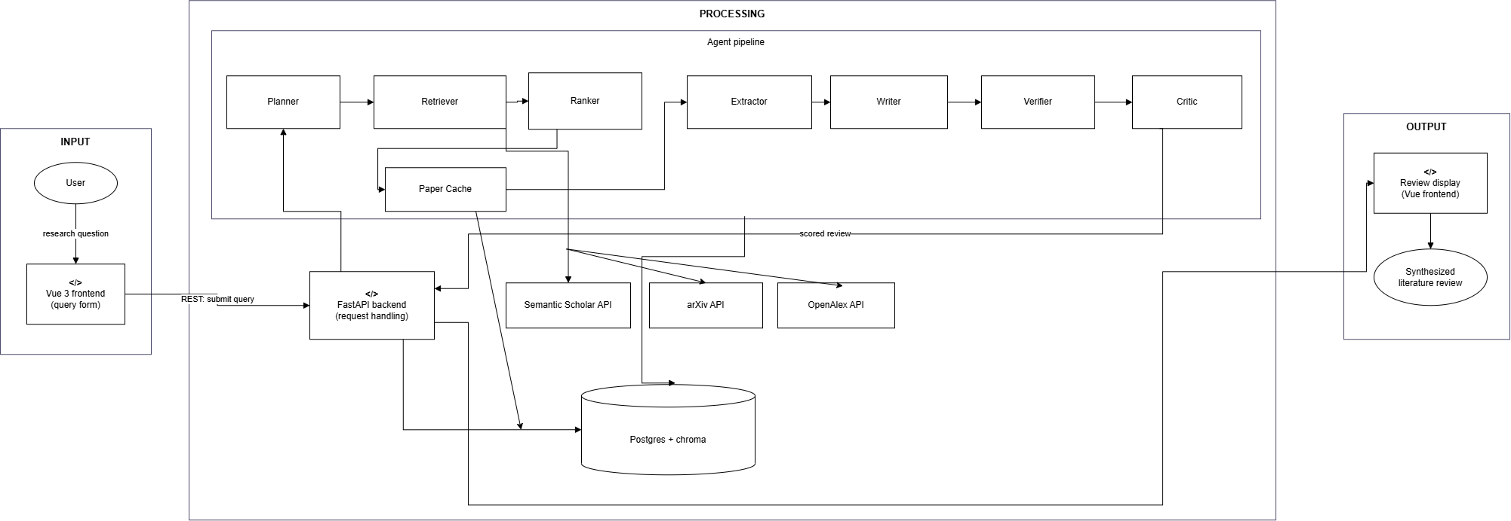
Proposed Method: Architecture Diagram

Slide 53
Proposed Method: Architecture Diagram
Input and planning. The researcher submits a question through the web application. If it is valid, the Planner turns it into two search queries and hands them to the Retriever; every agent after that reports its result back to the Planner.
Search and selection. The Retriever calls all three source APIs — OpenAlex, arXiv and Semantic Scholar — and merges what comes back, removing duplicates by DOI and then by title. The Ranker then orders the merged pool on each paper's abstract and keywords and keeps a one to ten ratio.
Reading and writing. The application downloads each selected paper's PDF and stores the full text in a local cache. The Extractor summarises each cached paper, and the Writer turns those summaries into a review with four sections: architecture, metrics, datasets, and advantages and disadvantages.
Checking. The Verifier splits the draft into single claims and scores each against the cached text it cites. Claims below the threshold are removed and recorded; those that stay carry their citation. A person then reviews what was removed.

Slide 54
Proposed Method: Architecture Diagram
Scoring and delivery. The Critic runs last and scores the finished review on its content and on the reasoning behind it, then hands it back to the backend. The backend streams progress to the frontend throughout the run, and the finished review is displayed with its evidence and offered for download, while the shared store keeps the papers, the cached text and the run records.

Slide 55
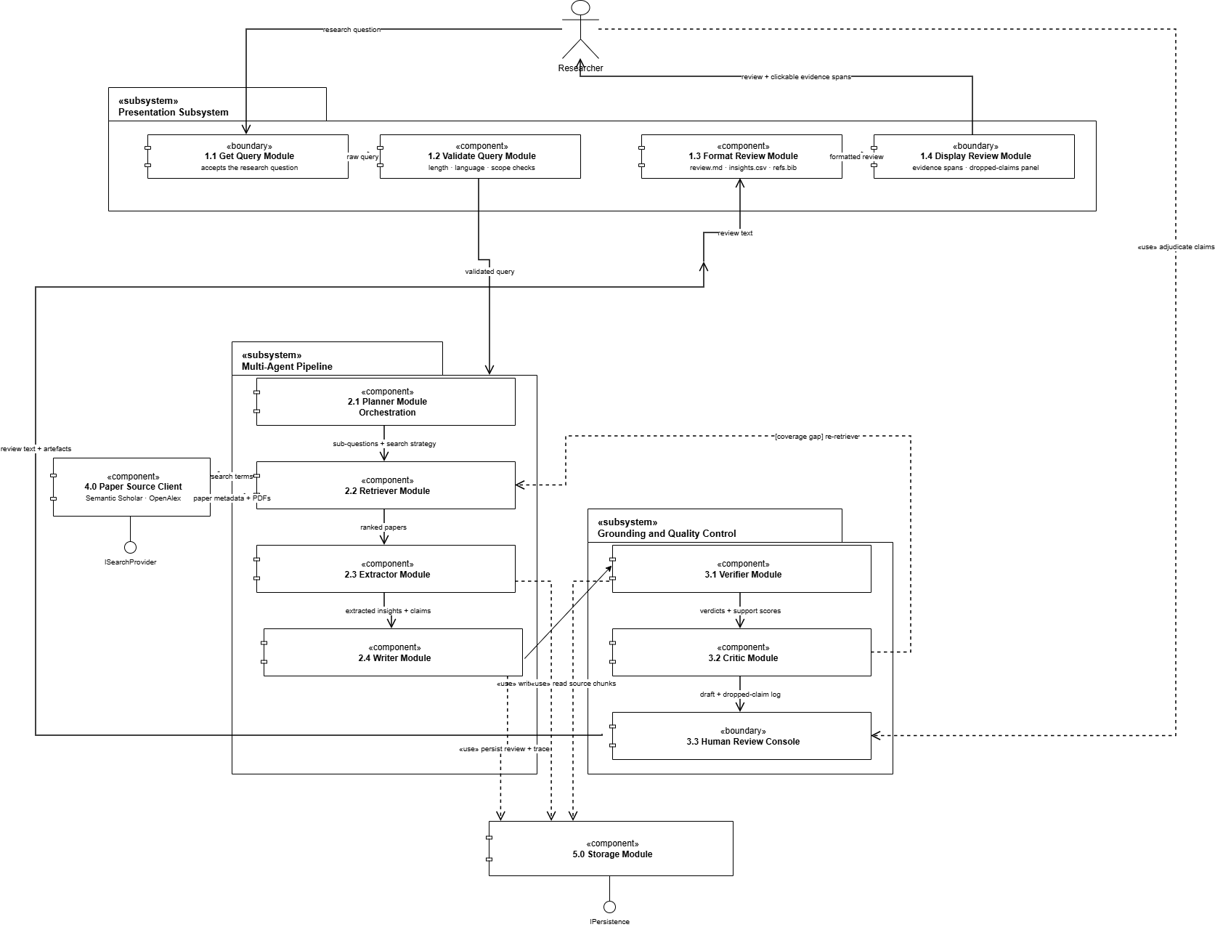
Proposed Method: Module Connectivity Diagram

Slide 56
Proposed Method: Module Connectivity Diagram
Three subsystems. The Query Intake Module collects and checks the question, the Central branch does the work, and the Display Module formats and shows the result. A single Main Controller sits above all three and routes between them.
The Planner is the orchestrator. Inside the Central branch the Planner calls each of the six pipeline modules in turn — Retriever, Ranker, Extractor, Writer, Verifier and Critic — and every one of them returns its result to the Planner rather than passing it sideways to the next module.

Slide 57
Proposed Method: Module Connectivity Diagram
Finding and shortlisting. The Retriever asks three client modules — OpenAlex, arXiv and Semantic Scholar — which all provide the same ISearchProvider interface, so a fourth source could be added without changing the Retriever. The Ranker then keeps a one to ten ratio.
Reading and writing. The Paper Cache Module downloads and stores the full text of each selected paper. The Extractor summarises from that cache, and the Writer composes the four sections of the review from those summaries.
Checking, scoring and storing. The Verifier grounds every statement against the cached source it cites; the Critic then scores the finished review and returns it to the Process Review Controller. The DB Access Module is the only module that touches Postgres, through IPersistence.

Slide 58
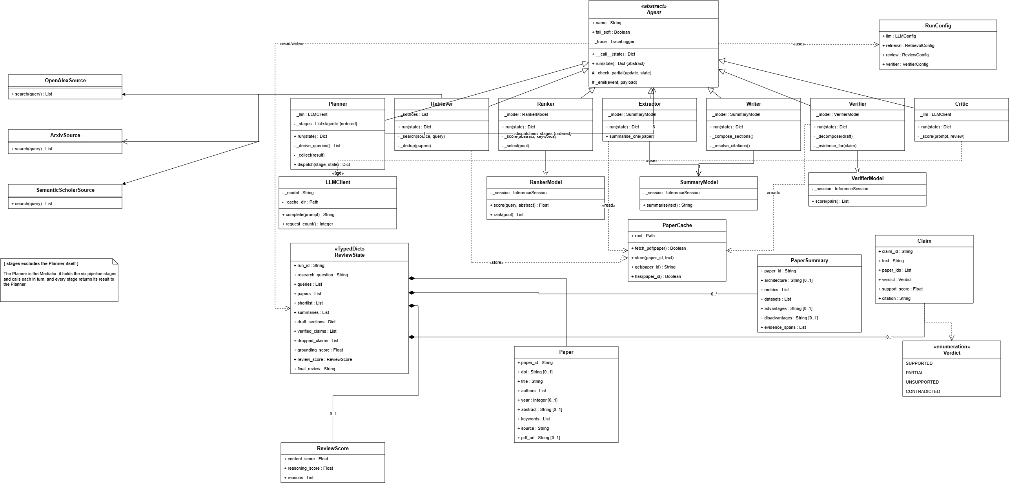
Class Diagram

Slide 59
Class Diagram
Inheritance. Agent is abstract and declares the template operation __call__() plus the abstract run(). All seven agents specialise it, which is what allows the trace record, the partial-state contract and the fail-soft policy to live in one place instead of seven.
The Planner is the Mediator. It holds the other six agents as _stages and calls each one through dispatch(). The association Planner 1 → 6 Agent carries the constraint that the Planner is never one of its own stages, which is what stops the hub calling itself.
Shared state. ReviewState is the record the Planner holds and every agent contributes to. It composes Paper, PaperSummary, Claim and ReviewScore; agents read and write it but never own it, which is why an agent returns a partial update rather than the whole state.
Models and sources. Ranker, Extractor, Writer and Verifier each hold a trained local model — and SummaryModel is held by two agents, which is the diagram reading of one model serving both. Only the Planner and the Critic depend on LLMClient, and PaperCache is written by the Retriever and read by the Extractor and the Verifier.

Slide 60
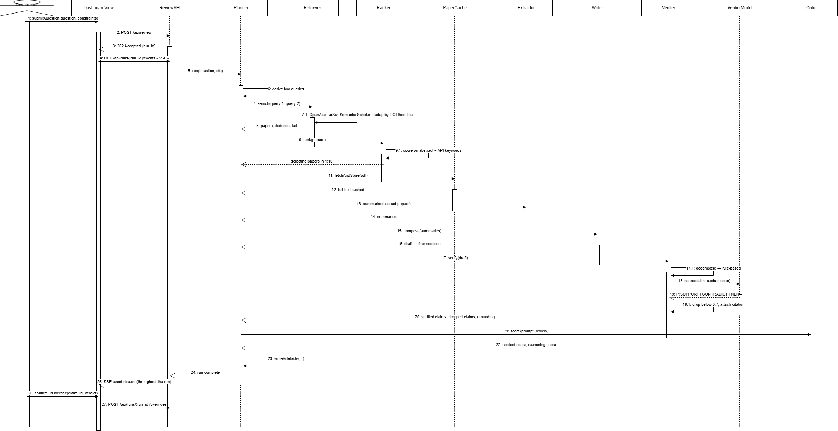
Sequence Diagram

Slide 61
Sequence Diagram
Planning and retrieval. The Planner derives two queries from the research question and passes them to the Retriever, which searches OpenAlex, arXiv and Semantic Scholar and returns one merged, deduplicated set. Every reply arrow returns to the Planner — that is what makes it the coordinator of the interaction rather than only its opening message.
Ranking and extraction. The Ranker orders the whole pool on the abstract and the keywords the source APIs return, then forwards a selection at a one to ten ratio. The Extractor reads each forwarded paper in full from the local cache and returns a summary of it, so what travels onward is summaries rather than papers.
Synthesis, verification and scoring. The Writer composes the review under four fixed headings — architecture, metrics, datasets, and advantages and disadvantages. The Verifier then re-checks every generated statement against the cached source text and attaches the citation it was grounded in. The Critic runs last, reading the original prompt and the finished review and scoring both the content and the reasoning behind it.

Slide 62
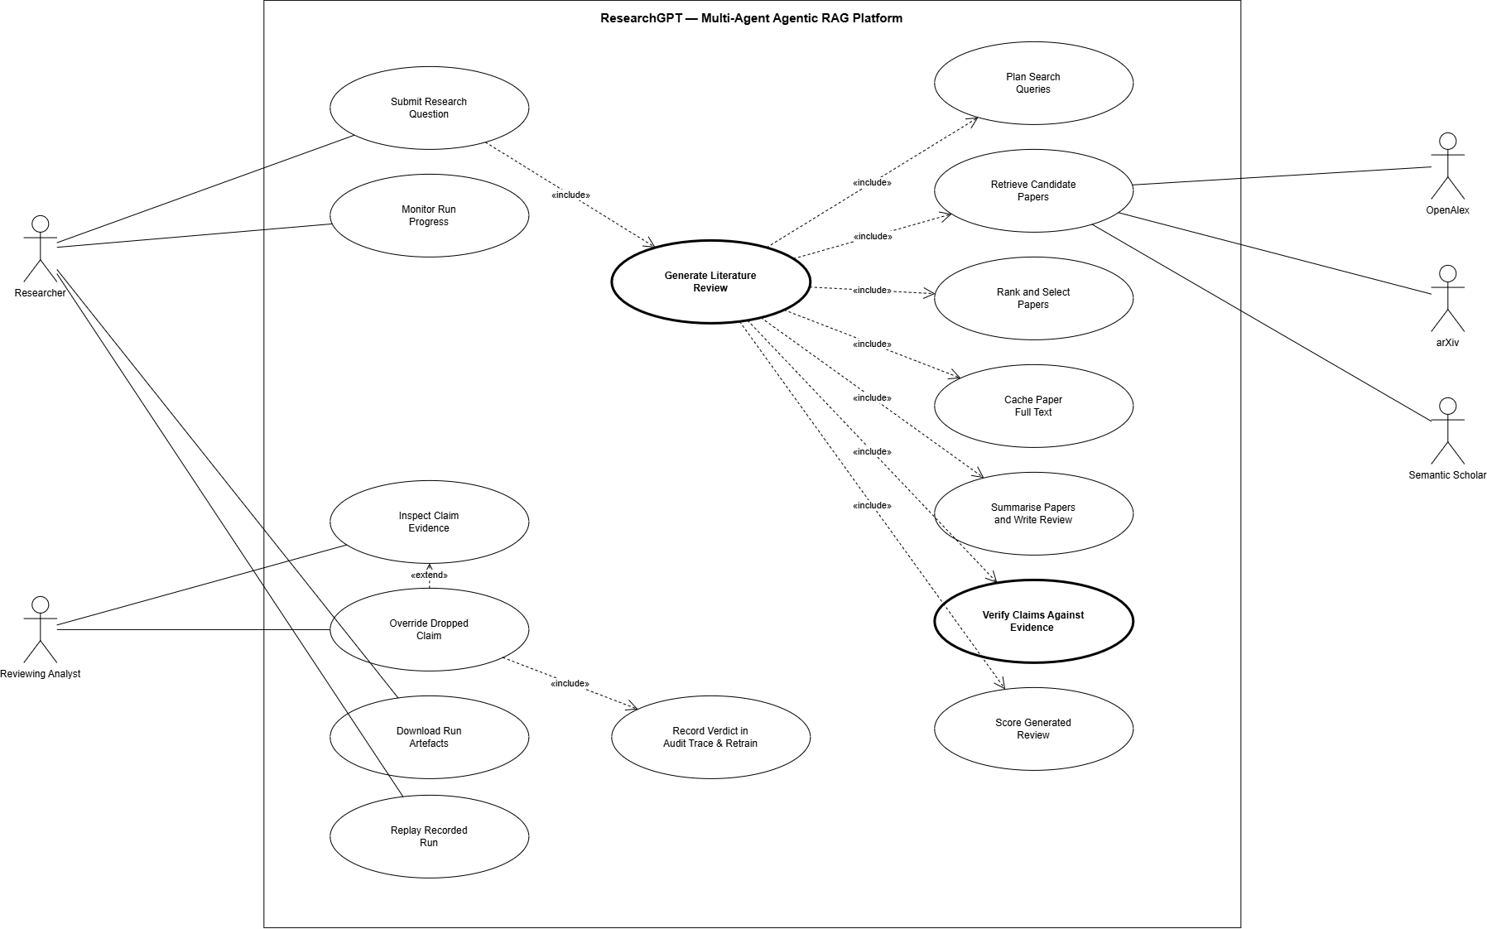
Use Case Diagram

Slide 63
Use Case Diagram
Actors. Researcher and Reviewing Analyst are the two human roles. OpenAlex, arXiv and Semantic Scholar are the three literature sources. All three are secondary actors and sit outside the boundary, because the system depends on them but does not own or control them.
Decomposition. Generate Literature Review includes the pipeline use cases, so each executes on every run without exception: plan the queries, retrieve, rank and select, extract, write, verify, and finally score. Override Dropped Claim is the one conditional path, and it is drawn as an extend for exactly that reason.
The graded use case. Verify Claims Against Evidence is the use case for which the surveyed literature offers no precedent. Score Generated Review is the Critic's use case and the last to execute — it judges the finished review on content quality and on whether the reasoning holds. Override Dropped Claim «include»s Record Verdict in Audit Trace and Retrain, so a reviewer's judgement is written into the permanent record and kept as labelled signal for a later retraining cycle.

Slide 64
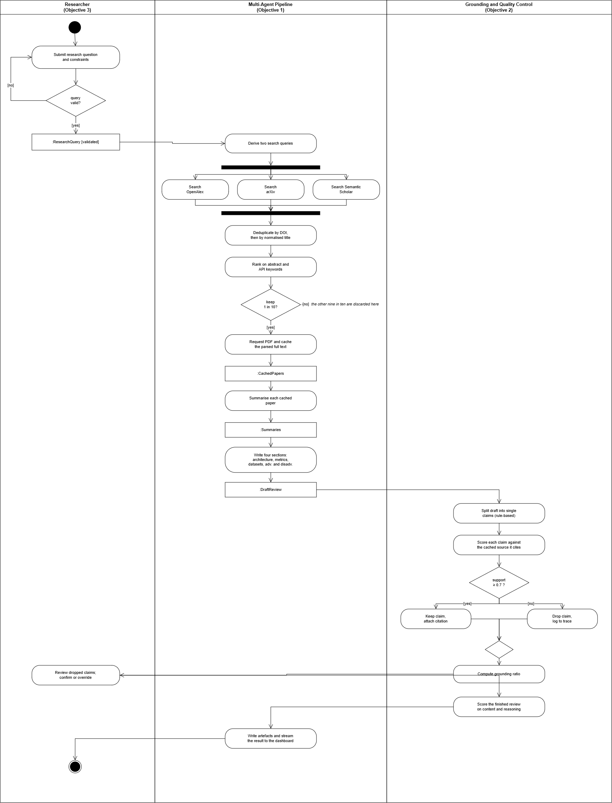
Activity Diagram

Slide 65
Activity Diagram
Input. The Researcher submits a question and constraints. A decision node returns an invalid query to the user, while a valid one produces the object node :ResearchQuery [validated], which crosses the partition edge to the Planner — where it becomes the two queries the rest of the activity runs on.
Concurrency. A fork issues the Planner’s queries against OpenAlex, arXiv and Semantic Scholar in parallel, and the join waits for all three before deduplication by DOI and then by normalised title. That join is where three independent source streams become one corpus.
Selection and summarisation. The Ranker orders the merged corpus on the abstract and the API keywords, and the selection step keeps a one to ten ratio before anything is read in full. Only the survivors reach the Extractor, which loads each paper's complete text from the cache and emits a summary object node.
Verification, scoring and hand-back. The Writer composes four sections from the summaries. Every generated statement then passes a [support_score ≥ 0.7] decision node against the cached source; the branches merge, surviving statements carry their citation, and the Critic scores the result. Dropped claims cross back into the Researcher partition for confirm-or-override before the artefacts are written.

Slide 66
Dataset Details
Dataset | Trains which component | Size actually used
SciFact (allenai/scifact_entailment) | Claim Verifier (deberta-v3, 44M) | 919 train / 340 validation rows
SciReviewGen (kejian/SciReviewGen) | Cross-encoder Ranker (22M) and Summary Generation model (139M) | 84,705 / 4,410 / 4,457 data instances
CNN / DailyMail | Summary Generation model (first-stage summarisation training) | 287,113 / 13,368 / 11,490 articles
Three datasets, three trained models. Each trained component has its own supervision signal, and no dataset is reused across purposes without being stated: SciReviewGen trains both the Ranker and the Summary Generation model, and separately supplies the retrieval gold sets those models are evaluated against.

Slide 67
Dataset Details
Live source / gold set | Role in the system | Size
OpenAlex | Primary live retrieval source | 1,000 searches/day (keyed)
arXiv | Second live retrieval source | Atom API, HTTPS only
Semantic Scholar | Third live retrieval source | Academic Graph API
Three live sources, one merged corpus. OpenAlex is the primary source and supplies most of the bibliographic metadata; arXiv adds recent preprints that the indexes are slow to list; Semantic Scholar covers what the other two miss. Results from all three are merged and deduplicated first by DOI and then by normalised title, so a paper found twice is still read once.
Only openly accessible papers enter the corpus. Each selected paper's PDF is requested and cached before it is read. Where a publisher paywall blocks the full text the paper cannot be ingested, so coverage is limited by what is openly available rather than by what retrieval can find.

Slide 68
Output (screenshots) of Test Cases or Case Study
screenshot to be placed here
Run control and live agent progress streamed over Server-Sent Events
Test case. Submit a research question through the single-page application and observe the six-agent pipeline execute without a page refresh.
Input. “How do multi-agent retrieval-augmented systems reduce hallucination in automated literature review?”, with the paper budget set to 5.
Expected. The submission is accepted with a run identifier, and each agent reports its start and completion in order as the run proceeds.
Observed. All seven agents transition in sequence — Planner, Retriever, Ranker, Extractor, Writer, Verifier, Critic — with progress read directly from the run’s trace file, so the browser and the report are derived from one record and cannot disagree.

Slide 69
Output (screenshots) of Test Cases or Case Study
screenshot to be placed here
Evidence inspection — a verified sentence and the exact span it was scored against
Test case. Every sentence in the delivered review must be traceable to the retrieved text span that justified it.
Expected. Clicking a marked sentence reveals the source paper, the chunk identifier, the character offsets and the quoted span the Verifier scored, together with the support score it produced.
Why it matters. The grounding figure becomes auditable rather than asserted — an examiner can re-derive it from the artefacts instead of taking it on trust.

Slide 70
Output (screenshots) of Test Cases or Case Study
screenshot to be placed here
Dropped claims, with support scores and the confirm
Test case. The system must refuse to publish what it cannot ground, and must let a human contest that refusal.
Expected. Claims scoring below the 0.7 support threshold are removed before the review is written and are logged with their scores, never silently discarded; an analyst’s verdict is appended to the run’s trace.
Observed. Three of 22 claims were dropped. Claims c0006 (0.2169) and c0020 (0.0098) both asserted detection accuracy above 99% that the cited paper never reports, and c0022 (0.0061) attributed a semantic-validation claim to a paper about repository provenance.
Why it matters. Those three sentences are precisely the failure mode this project exists to prevent: fluent, plausible, correctly cited and unsupported.

Slide 71
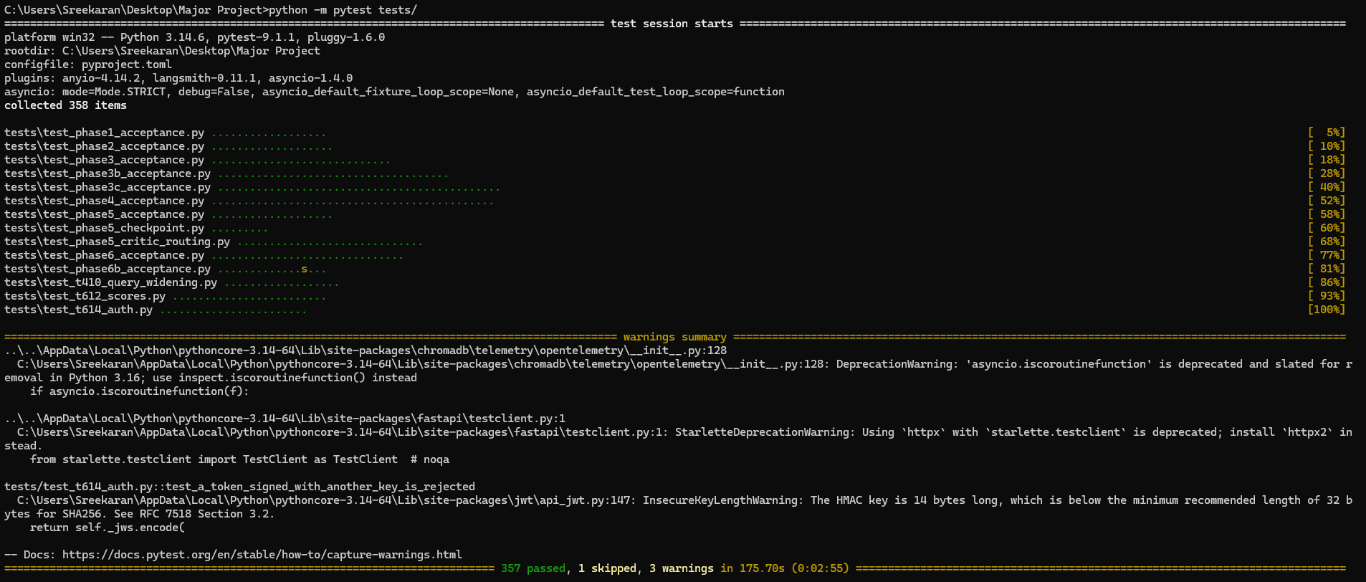
Output (screenshots) of Test Cases or Case Study
Test case. The acceptance criterion is the test: each phase of the project ships an executable acceptance suite rather than a prose checklist.
Expected. The full suite passes on a clean checkout with no network access and no database configured.
Observed. 357 tests pass and 1 is skipped, across 13 suites: one acceptance suite per project phase, plus unit and integration tests.
Why it matters. Three defects of consequence were found by writing a test rather than by running the code — a trace override that corrupted two records at once, a registry connection that could hang a run indefinitely, and a run index that hid 58 of 60 runs the moment it was enabled.

Slide 72
Experimental Results in the Table Format
Component | Trained? | Base model | Params | Training data | Deployment
Cross-encoder Ranker | Trained | marco-MiniLM | 22M | SciReviewGen | CPU, ONNX int8
Extractor + Writer (Summary Generation) | Trained | bart-base | 139M | CNN/DailyMail, then SciReviewGen | CPU, ONNX int8
Claim Verifier | Trained | deberta-v3 | 44M | SciFact | CPU, ONNX int8
Planner | Prompted | openai/gpt-oss-20b (open-weight) | 20B | — | Self-hosted
Critic (scoring) | Prompted | openai/gpt-oss-20b (open-weight) | 20B | — | Self-hosted
Embeddings | Frozen | BAAI/bge-small-en-v1.5 | 33M | — | CPU
Three models are trained, roughly 205M parameters combined, all trained on free GPU time and all deployed int8-quantised on a CPU-only machine.
The two prompted seats are the Planner and the Critic. The Planner turns a research question into queries and the Critic judges a finished review; both are reasoning tasks rather than transcription, and both are served by the same open-weight model without training.
The three trained models sit at the three bottlenecks. Ranking decides how papers are ranked, summarisation decides what the Writer ever sees, and claim grounding decides what survives into the delivered review. Those are the places where a trained model changes the output, which is why they are the places that were trained.

Slide 73
Experimental Results in the Table Format
Model | Metric | Evaluation set | Measured
Cross-encoder Ranker | Recall@20 | 35 papers | 0.775
Cross-encoder Ranker | nDCG@10 | 35 papers | 0.762
Summary Generation | ROUGE-1 | SciReviewGen test | 33.82
Summary Generation | ROUGE-L | SciReviewGen test | 29.44
Claim Verifier | Macro-F1 | SciFact held out, 628 pairs | 0.873
Claim Verifier | Accuracy | SciFact held out, 628 pairs | 0.881
Two metrics per model. Recall@20 is the Ranker's adoption gate — the share of the answer key it puts in front of the Extractor — and nDCG@10 says whether the ones it found are near the top. Together they cover both finding and ordering.
ROUGE-1 and ROUGE-L for the summariser. ROUGE-1 measures how much of the reference wording is recovered and is the most interpretable of the family; ROUGE-L rewards the longest matching subsequence, so it is the one that reflects whether the sentence structure survived.
Macro-F1 and accuracy for the verifier. Macro-F1 weights the three verdicts equally, so a model that is right about the common class and wrong about the rest cannot hide behind it; accuracy is the plain share of claims judged correctly. Both are measured on the held-out SciFact split.

Slide 74
Significance of the Proposed Work
It prevents a failure that has been measured, not imagined. Across four independent studies a citation turns out to be almost no evidence that a sentence is true — FActScore found citations on 36.0% of supported and 37.6% of unsupported sentences alike. This system deletes what it cannot ground, so a reader is not left checking every line by hand.
No existing system does this inside the loop. To the best of our knowledge no published system and no deployed tool removes an unsupported sentence before the review is delivered. Existing work either scores text after it is written or writes without checking at all.
Every sentence can be traced back to its source. Each surviving claim keeps the exact span it was scored against, so the grounding figure can be recalculated from the saved files rather than taken on trust.
It runs on an ordinary computer, at no cost. Three small trained models, quantised and self-hosted on CPU, put grounded literature review within reach of a researcher with no GPU and no budget.
A person keeps the final say. Every removed claim is shown with its score and its evidence, and the reviewer's decision to accept or overrule it is written into the permanent record of the run.

Slide 75
Advantages of the Proposed Work
Unsupported sentences never reach the reader. What is delivered is what survived verification. That is a stronger guarantee than a confidence score attached to text that ships regardless.
Evidence is a first-class part of the output. Every claim keeps the source chunk, the character offsets and the quoted span it was checked against, which is what makes the evidence panel a demonstration rather than a claim.
One agent holds the whole run. Every agent reports its result back to the Planner, so there is a single place to look when a run goes wrong instead of seven.
Measured results at every trained stage. Ranker Recall@20 0.775, summariser ROUGE-L 29.44 and verifier macro-F1 0.873 — each measured after int8 quantisation, on the build that actually ships.
One record governs everything. The event trace is the single source of truth: the live progress display, the human overrides and every figure in this deck all come from it, so the running system and the reported results cannot disagree.

Slide 76
Limitations of the Proposed Method
Papers behind a paywall are never used. The Paper Extractor ingests only openly accessible full text. Articles held behind subscription publishers — IEEE Xplore, ScienceDirect and comparable journals — cannot be fetched, so their content is absent from the corpus even when retrieval correctly identifies them as relevant, and any claim that would have depended on them cannot be grounded.
Ranking happens on metadata, before any paper is read. The Ranker orders the pool on the abstract and the keywords the source APIs return, so a paper whose abstract undersells it is cut before its full text is ever loaded into the cache.
The training data is domain-shifted relative to the target corpus. SciFact is biomedical and expert-curated.
The Ranker’s scores are compressed and must never be thresholded. Only its ordering carries signal. A raw-score cutoff would mis-rank silently, so the code raises an error on any attempt to threshold a non-stock model rather than permitting it.

Slide 77
Status of Project’s Execution
The system is complete and runs end to end. All seven agents, the Planner-coordinated pipeline, the backend with live progress streaming and human-in-the-loop overrides, and the four-panel web frontend are implemented and demonstrable.
All three models are trained, evaluated, quantised and adopted. Claim Verifier at macro-F1 0.873, Cross-encoder Ranker at Recall@20 0.775 out of domain, and the Summary Generation model at ROUGE-L 29.44 — each promoted only after clearing a pre-specified gate.
334 automated tests pass and 1 is skipped, one acceptance suite per project phase plus unit and integration tests, requiring neither network access nor a database.

Slide 78
References
[1] T. Bao, M. T. Nayeem, D. Rafiei and C. Zhang, "SurveyGen: Quality-Aware Scientific Survey Generation with Large Language Models," in Proc. 2025 Conf. Empirical Methods in Natural Language Processing (EMNLP), 2025. https://doi.org/10.18653/v1/2025.emnlp-main.136
[2] T. Kasanishi, M. Isonuma, J. Mori and I. Sakata, "SciReviewGen: A Large-Scale Dataset for Automatic Literature Review Generation," in Findings of the Association for Computational Linguistics: ACL 2023, 2023, p. 6700. https://doi.org/10.18653/v1/2023.findings-acl.418
[3] M. Funkquist, I. Kuznetsov, Y. Hou and I. Gurevych, "CiteBench: A Benchmark for Scientific Citation Text Generation," in Proc. 2023 Conf. Empirical Methods in Natural Language Processing (EMNLP), 2023, p. 7344. https://doi.org/10.18653/v1/2023.emnlp-main.455
[4] F. J. Bolaños, A. A. Salatino, F. Osborne and E. Motta, "Artificial Intelligence for Literature Reviews: Opportunities and Challenges," Artificial Intelligence Review, vol. 57, 2024. https://doi.org/10.1007/s10462-024-10902-3
[5] B. Edelman and J. Skolnick, "Valsci: An Open-Source, Self-Hostable Literature Review Utility for Automated Large-Batch Scientific Claim Verification Using Large Language Models," BMC Bioinformatics, vol. 26, 2025. https://doi.org/10.1186/s12859-025-06159-4

Slide 79
References
[6] S. Es, J. James, L. Espinosa-Anke and S. Schockaert, "RAGAs: Automated Evaluation of Retrieval Augmented Generation," in Proc. 18th Conf. European Chapter of the Association for Computational Linguistics (EACL): System Demonstrations, 2024, p. 150. https://doi.org/10.18653/v1/2024.eacl-demo.16
[7] S. Min, K. Krishna, X. Lyu, M. Lewis, W. Yih, P. W. Koh, M. Iyyer, L. Zettlemoyer and H. Hajishirzi, "FActScore: Fine-Grained Atomic Evaluation of Factual Precision in Long Form Text Generation," in Proc. 2023 Conf. Empirical Methods in Natural Language Processing (EMNLP), 2023, p. 12084. https://doi.org/10.18653/v1/2023.emnlp-main.741
[8] T. Gao, H. Yen, J. Yu and D. Chen, "Enabling Large Language Models to Generate Text with Citations," in Proc. 2023 Conf. Empirical Methods in Natural Language Processing (EMNLP), 2023, p. 6465. https://doi.org/10.18653/v1/2023.emnlp-main.398
[9] L. Huang, W. Yu, W. Ma, W. Zhong, Z. Feng, H. Wang, Q. Chen, W. Peng, X. Feng, B. Qin et al., "A Survey on Hallucination in Large Language Models: Principles, Taxonomy, Challenges and Open Questions," ACM Transactions on Information Systems, 2024. https://doi.org/10.1145/3703155
[10] H. Liu, A. Soroush, J. G. Nestor, E. Park, B. Idnay, Y. Fang, J. Pan, S. Liao, M. Bernard, Y. Peng et al., "Retrieval Augmented Scientific Claim Verification," JAMIA Open, vol. 7, no. 1, 2024. https://doi.org/10.1093/jamiaopen/ooae021

Slide 80
References
[11] J. Dagdelen, A. Dunn, S. Lee, N. Walker, A. S. Rosen, G. Ceder, K. A. Persson and A. Jain, "Structured Information Extraction from Scientific Text with Large Language Models," Nature Communications, vol. 15, 2024. https://doi.org/10.1038/s41467-024-45563-x
[12] M. J. Sarol, S. Ming, S. Radhakrishna, J. Schneider and H. Kilicoglu, "Assessing Citation Integrity in Biomedical Publications: Corpus Annotation and NLP Models," Bioinformatics, vol. 40, no. 7, 2024. https://doi.org/10.1093/bioinformatics/btae420
[13] S. Jeong, J. Baek, S. Cho, S. J. Hwang and J. C. Park, "Adaptive-RAG: Learning to Adapt Retrieval-Augmented Large Language Models through Question Complexity," in Proc. 2024 Conf. North American Chapter of the Association for Computational Linguistics (NAACL-HLT), 2024, pp. 7036–7050. https://doi.org/10.18653/v1/2024.naacl-long.389
[14] W. Yu, H. Zhang, X. Pan, P. Cao, K. Ma, J. Li, H. Wang and D. Yu, "Chain-of-Note: Enhancing Robustness in Retrieval-Augmented Language Models," in Proc. 2024 Conf. Empirical Methods in Natural Language Processing (EMNLP), 2024, p. 14679. https://doi.org/10.18653/v1/2024.emnlp-main.813

Slide 81
References
[15] M. Jeong, J. Sohn, M. Sung and J. Kang, "Improving Medical Reasoning through Retrieval and Self-Reflection with Retrieval-Augmented Large Language Models," Bioinformatics, vol. 40, suppl. 1, 2024. https://doi.org/10.1093/bioinformatics/btae238
[16] A. Y. Aytar, K. Kaya and K. Kılıç, "A Synergistic Multi-Stage RAG Architecture for Boosting Context Relevance in Data Science Literature," Natural Language Processing Journal, 2025. https://doi.org/10.1016/j.nlp.2025.100179
[17] P. Ammann, J. Golde and A. Akbik, "Question Decomposition for Retrieval-Augmented Generation," in Proc. 63rd Annu. Meeting of the Association for Computational Linguistics: Student Research Workshop, 2025, p. 501. https://doi.org/10.18653/v1/2025.acl-srw.32
[18] C. Qian, W. Liu, H. Liu, N. Chen, Y. Dang, J. Li, C. Yang, W. Chen, Y. Su, X. Cong, J. Xu, D. Li, Z. Liu and M. Sun, "ChatDev: Communicative Agents for Software Development," in Proc. 62nd Annu. Meeting of the Association for Computational Linguistics (Long Papers), 2024. https://doi.org/10.18653/v1/2024.acl-long.810
[19] X. Li, S. Wang, S. Zeng, Y. Wu and Y. Yang, "A Survey on LLM-Based Multi-Agent Systems: Recent Advances and New Frontiers in Application," Vicinagearth, vol. 1, no. 9, 2024. https://doi.org/10.1007/s44336-024-00009-2

Slide 82
References
[20] T. Yang, P. Feng, Q. Guo, J. Zhang, X. Zhang, J. Ning, X. Wang and Z. Mao, "AutoHMA-LLM: Efficient Task Coordination and Execution in Heterogeneous Multi-Agent Systems Using Hybrid Large Language Models," IEEE Transactions on Cognitive Communications and Networking, 2025. https://doi.org/10.1109/TCCN.2025.3528892
[21] B. Peng, Y. Zhu, Y. Liu, X. Bo, H. Shi, C. Hong, Y. Zhang and S. Tang, "Graph Retrieval-Augmented Generation: A Survey," ACM Transactions on Information Systems, 2025. https://doi.org/10.1145/3777378
[22] Y. Lyu, Z. Li, S. Niu, F. Xiong, B. Tang, W. Wang, H. Wu, H. Liu, T. Xu and E. Chen, "CRUD-RAG: A Comprehensive Chinese Benchmark for Retrieval-Augmented Generation of Large Language Models," ACM Transactions on Information Systems, 2024. https://doi.org/10.1145/3701228
[23] S. Siriwardhana, R. Weerasekera, E. Wen, T. Kaluarachchi, R. Rana and S. Nanayakkara, "Improving the Domain Adaptation of Retrieval Augmented Generation (RAG) Models for Open Domain Question Answering," Transactions of the Association for Computational Linguistics, vol. 11, 2023. https://doi.org/10.1162/tacl_a_00530

